Slide 1

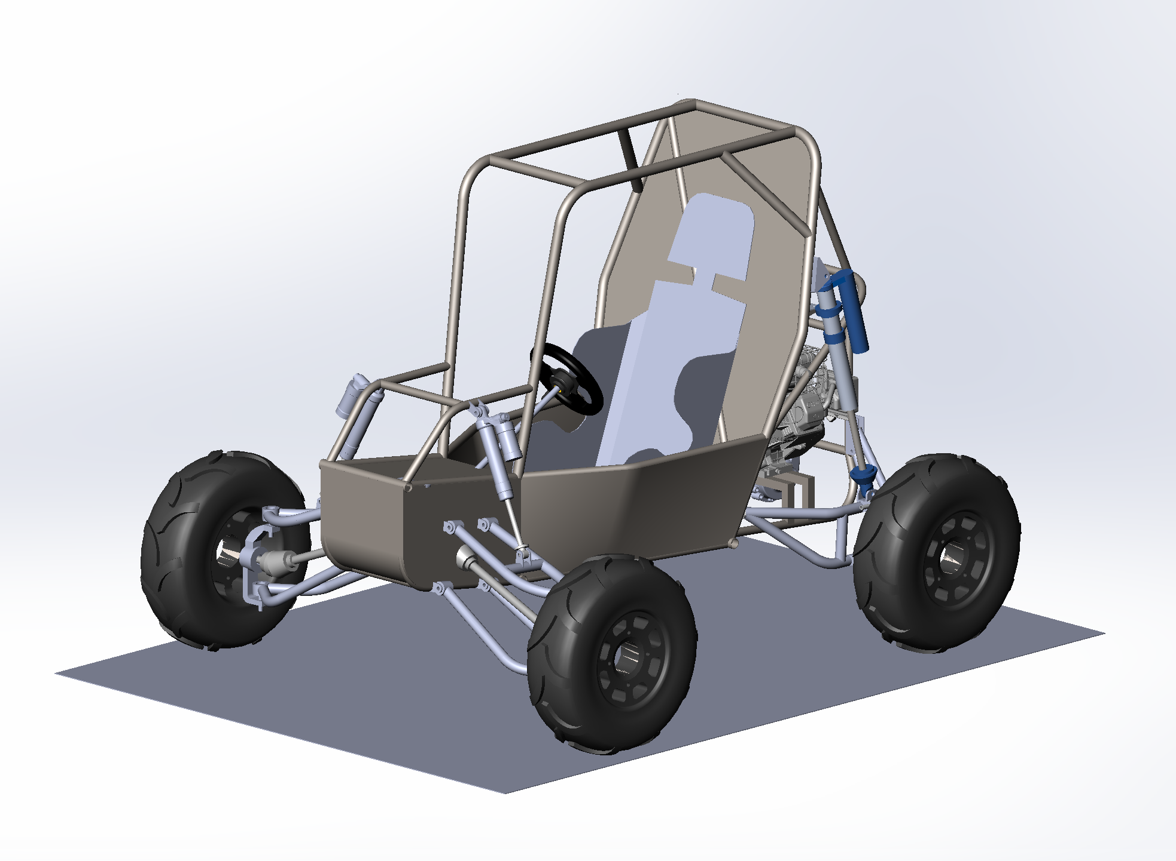

Baja SAE 2021
Presenters:
Umut Ayyildiz
Alessandro Belaj
Daniel Cohen
Fathema Islam
Brian Kazi
David Kim
Yusuf Wong

Slide 2
SAE Baja Competition
Our role in the competition has changed drastically due to our inability to access the shop and materials on campus. Because we won’t be able to attend the Validation Event for the competition, our focus has changed from using the old chassis to developing a new one for the next year’s team.
Knowledge Event:
Notice of Intent - 4wd / AWD --------------------------- February, 15, 2021, 11:59:59 PM EST
Written Cost Reduction Report* ---------------------- February 15, 2021, 11:59:59 PM EST
Business Plan* ---------------------------------------------- February 19, 2021, 11:59:59 PM EST
Presentation Event ----------------------------------------- March 18-19, 2021
Online Cost Prototype* ----------------------------------- March 29, 2021, 11:59:59 PM EDT
Design Review Briefing* ---------------------------------- March 31, 2021, 11:59:59 PM EDT
Design Event -------------------------------------------------- April 10-18, 2021

Slide 3
Brakes
Steering
Driver
Powertrain
Electronic Systems
Brake Pedal
Gas Pedal
Chassis
Power Supply
Steering Wheel
Master Cylinder
Engine
Coilovers
Data Acquisition
AWD Control Unit
Steering Column
CVT
Adjusting Shaft
Suspension Geometry
Strain Gage
Cam Actuator
Rack and Pinion
Gearbox
Lines
Accelerometer
Knuckle
Calipers
Front/Rear Differential
Multiplate Wet Clutch Pack
Tie Rods
Wheels
Hall Sensors
Brake Pads
Traction/Impact Forces
Driveshafts
Rotors
Suspension

Slide 4
Design Updates
Chassis
Suspension Points added in and Overall Ground Clearance was increased
Surface Models of the Firewall, Skid Plate, and Driver Protection were added
Suspension
Control arms were designed and simulated using ANSYS Mechanical
Front Knuckle was created to match LOTUS Points well
Powertrain
Actuation was changed from Electromagnetic to Cam-actuated through the use of a stepper/servo motor
All shafts and supporting hardware were validated throughout the powertrain to support torque values at various points in the system

Slide 5
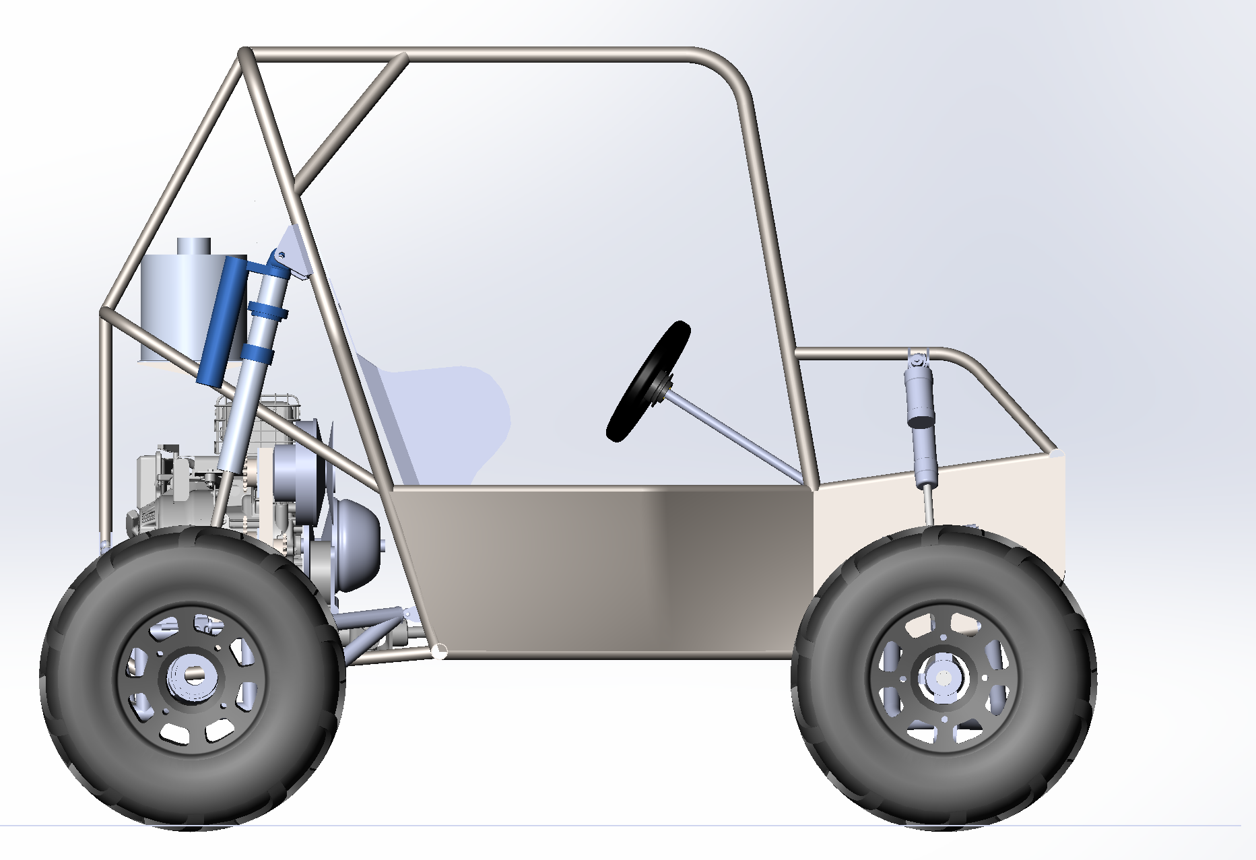
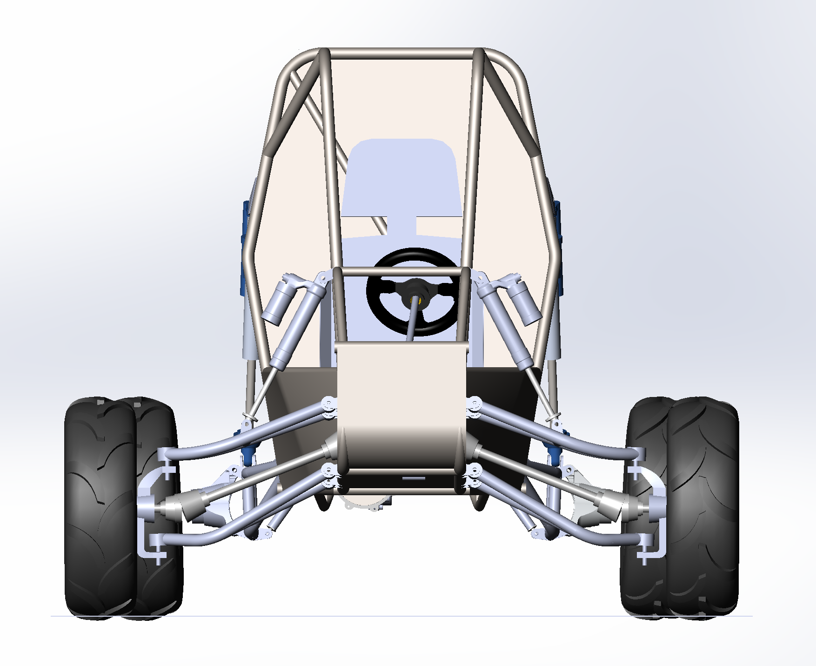
Overall Design
Overall Design of Baja Chassis

Slide 6
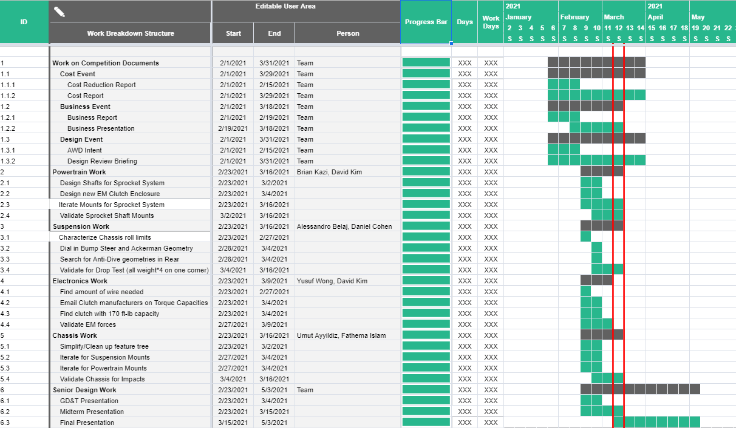
Gantt Chart

Slide 7
Chassis

Slide 8
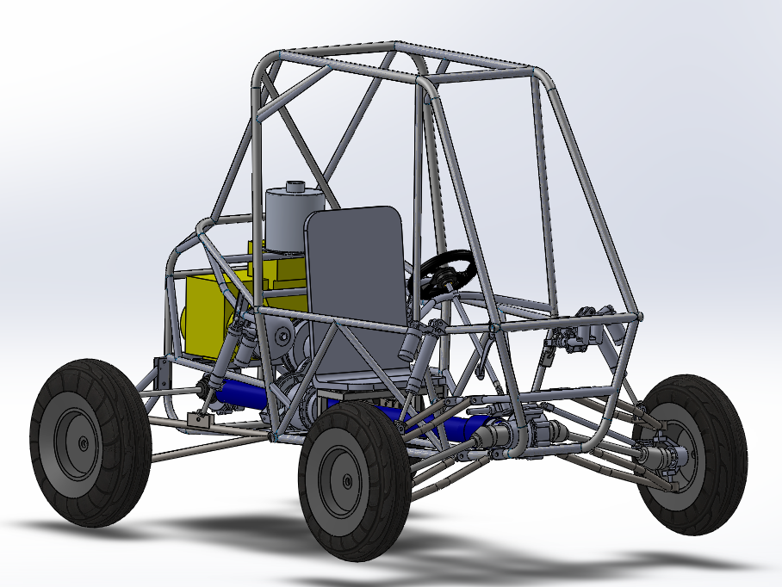
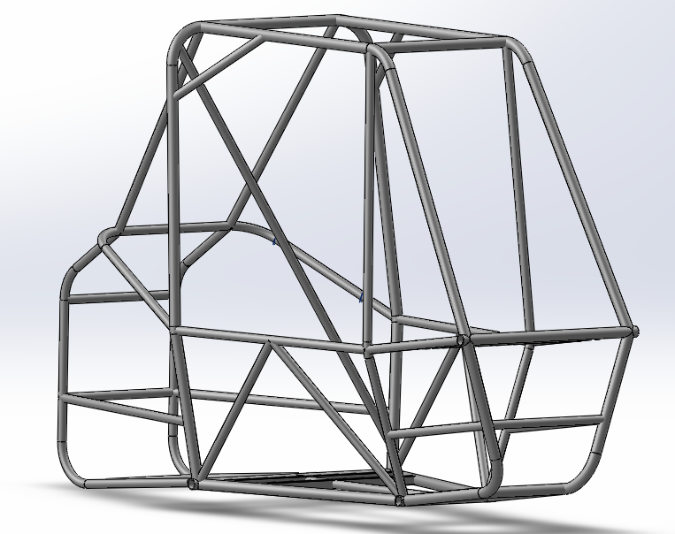
Recap of Previous Chassis Design
2020 Chassis

Slide 9
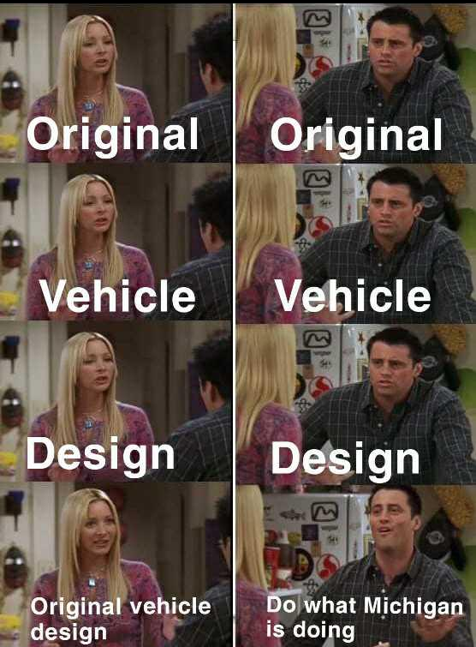
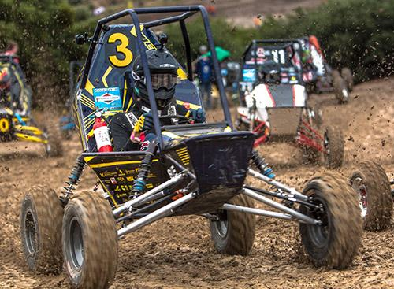
Design Philosophy
Smaller Chassis
More Efficient with space
Reduce weight
Add Mounting Points
Winning Design
Meme

Slide 10
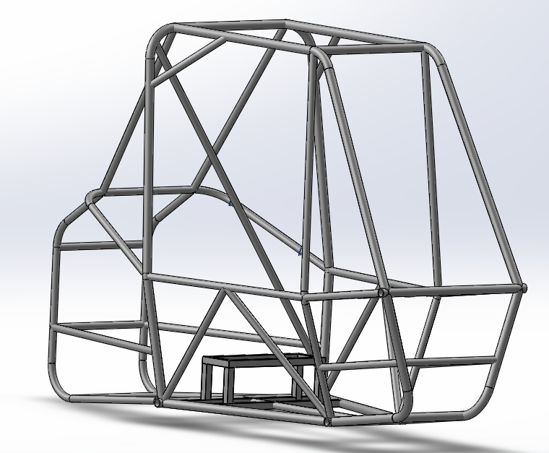
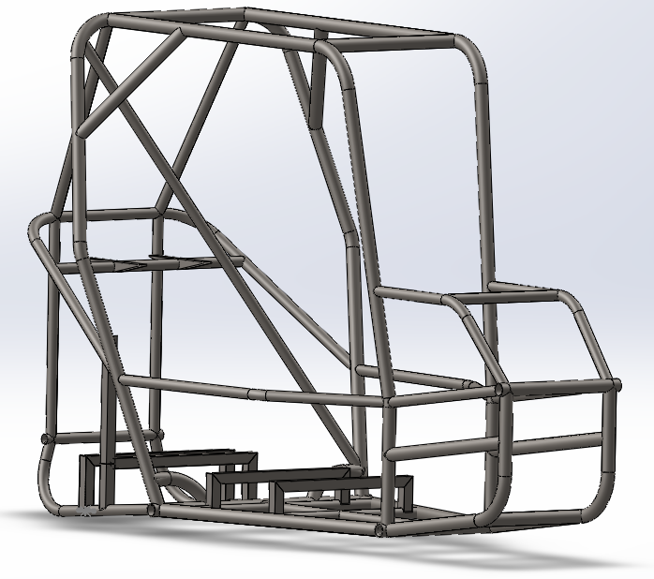
Design Changes
2020 Design
2021 Design
Notes:
Mention the overall design changes from prior design

Slide 11
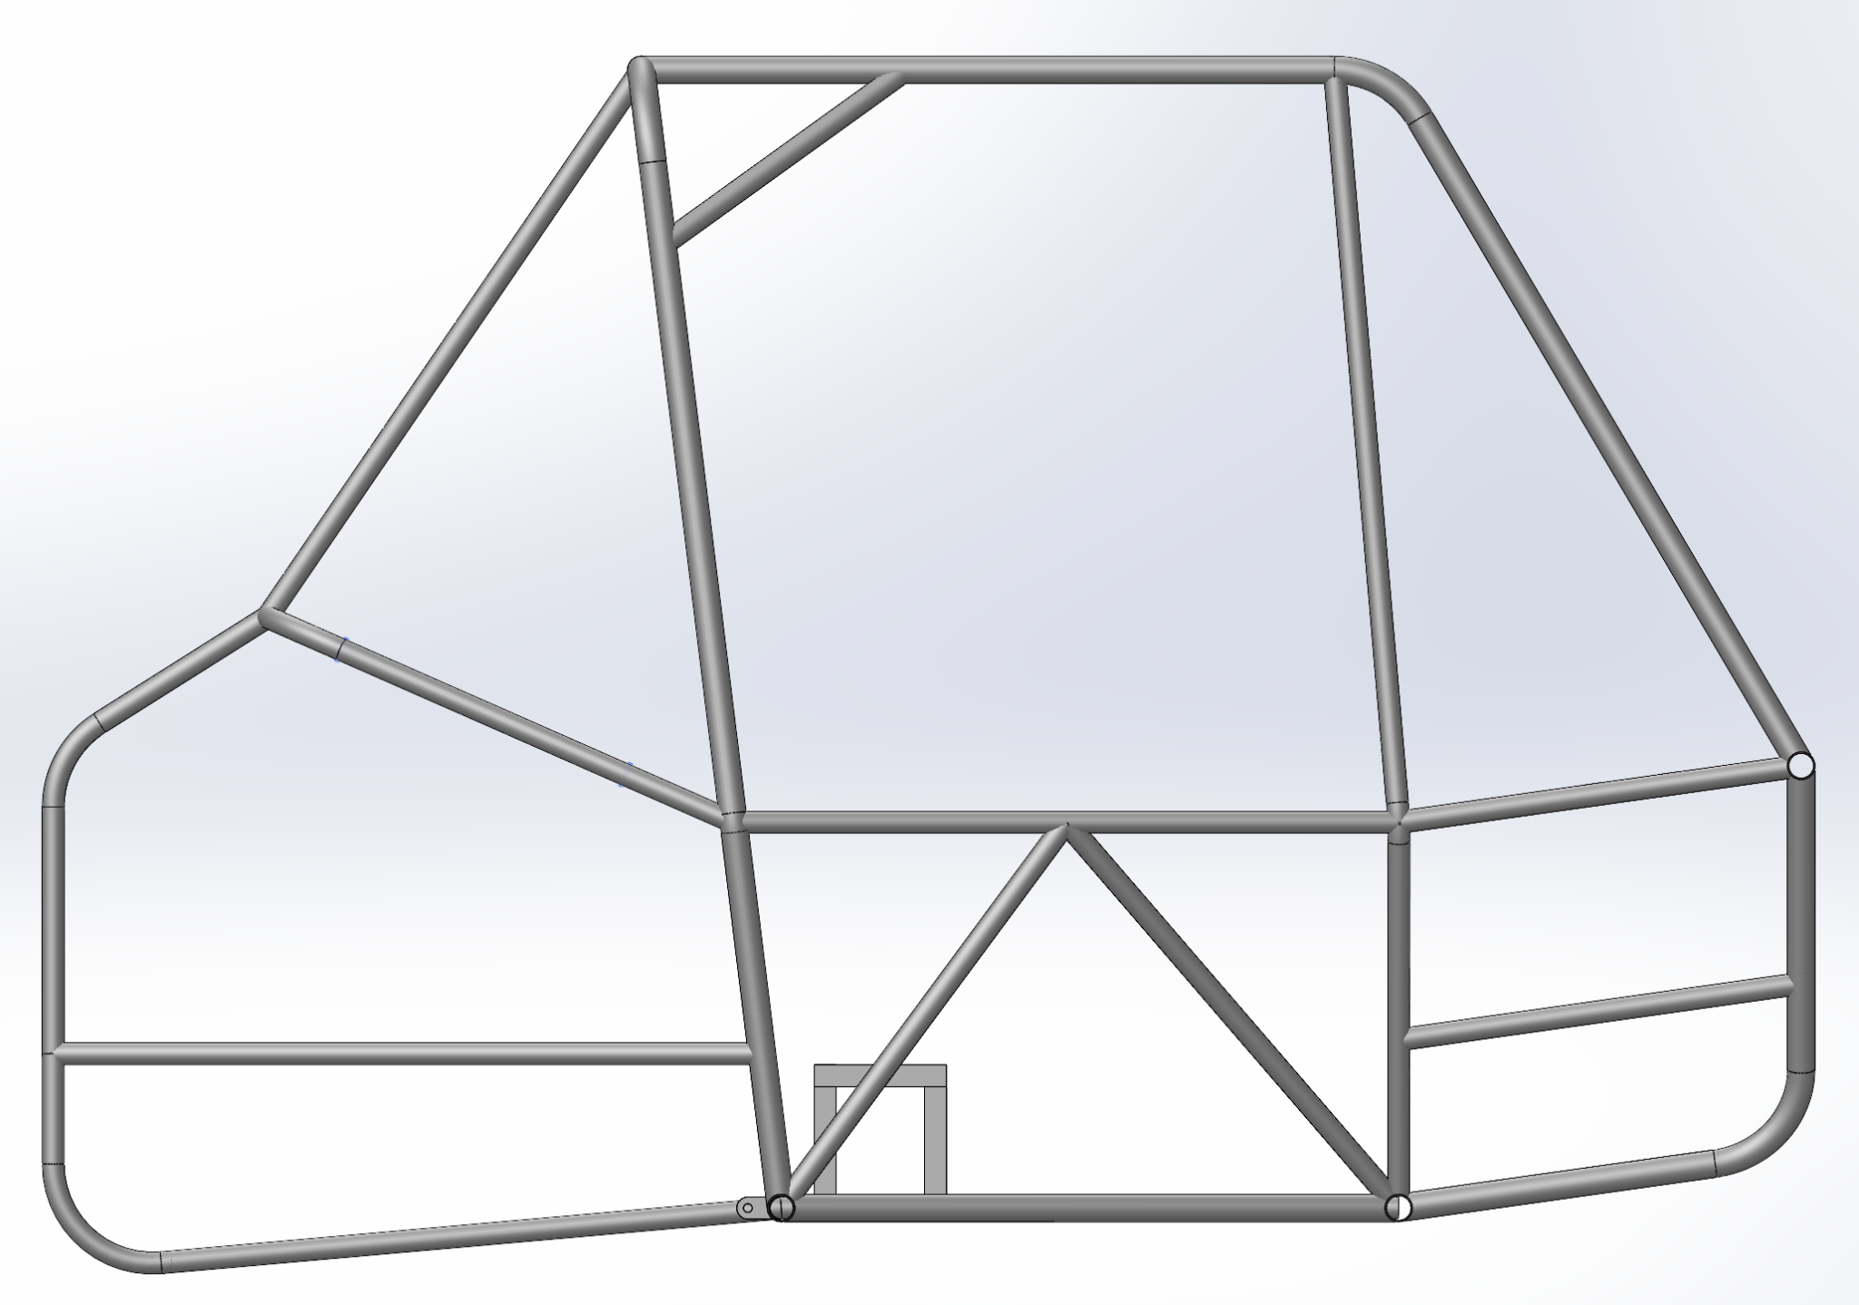
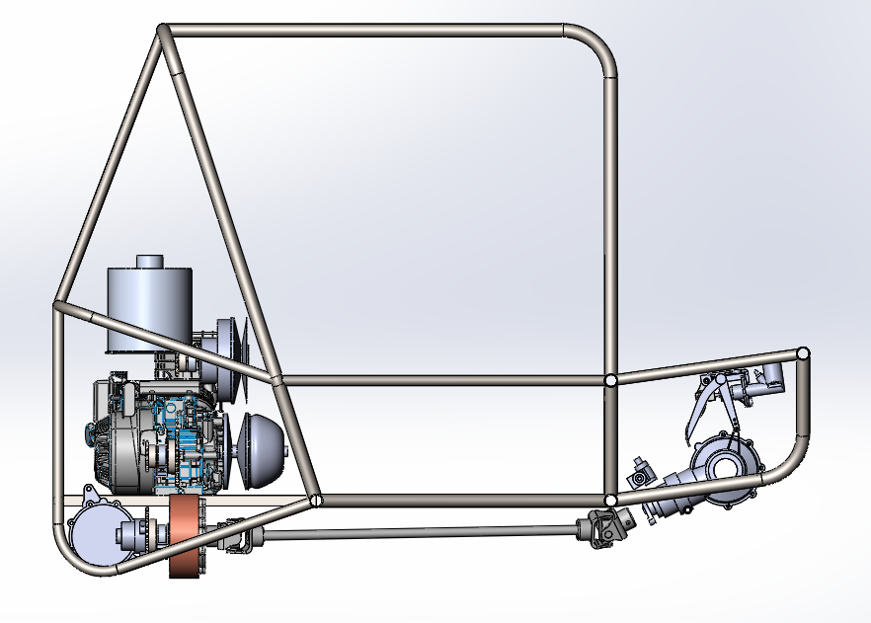
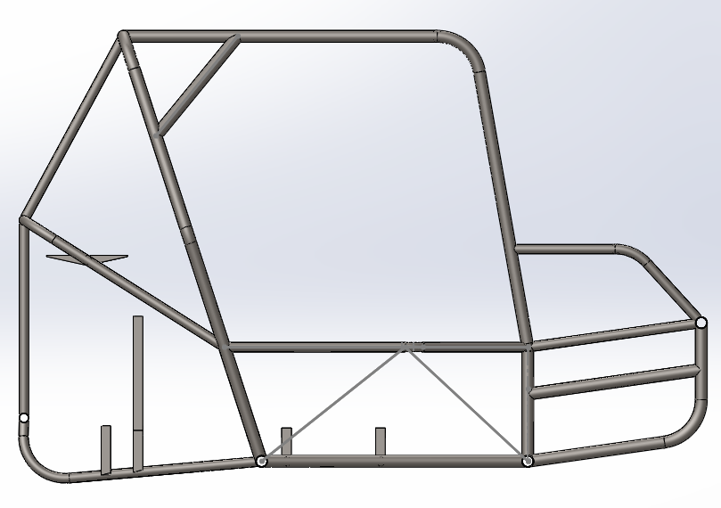
Design Changes
2020 Chassis Final
2021 Chassis v1
2021 Chassis v2
Notes:
Increased ground clearance with rear chassis
Added Front suspension Mounting points
Added Powertrain Mounting Points, Fuel Tank Mount and Seat Mount Points

Slide 12
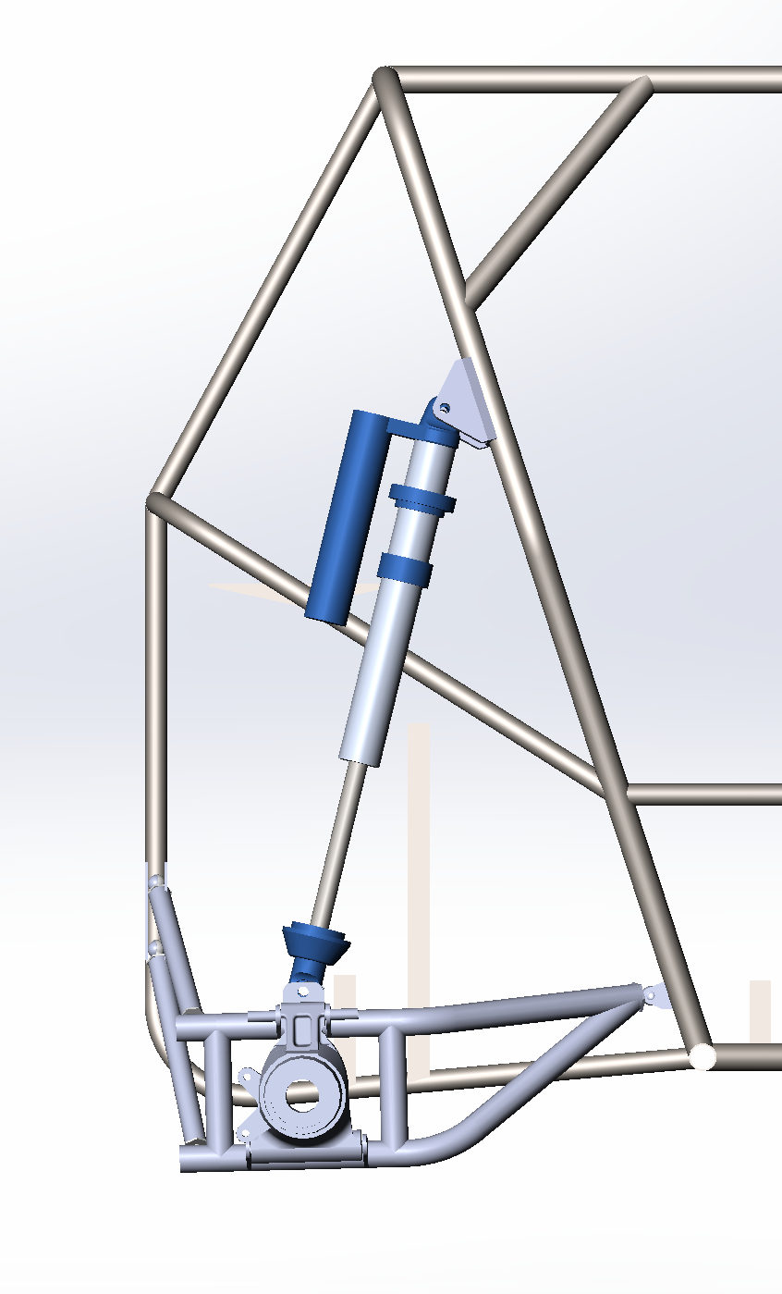
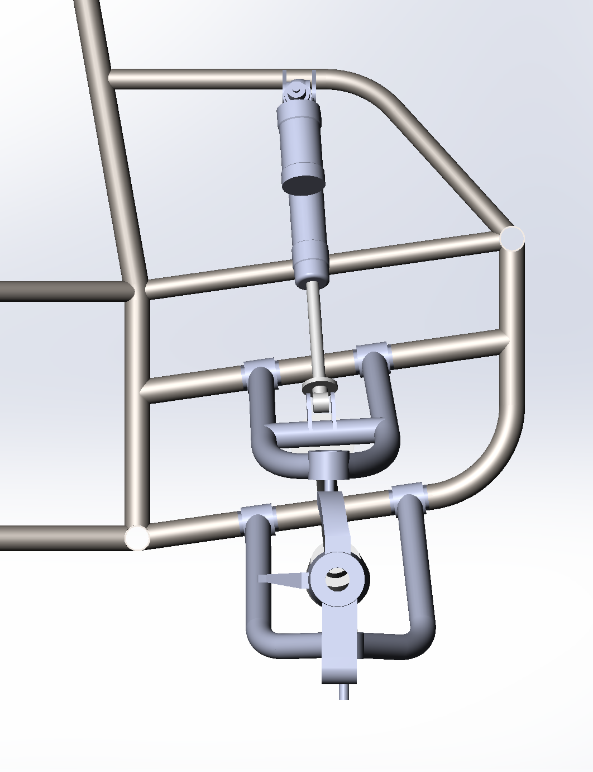
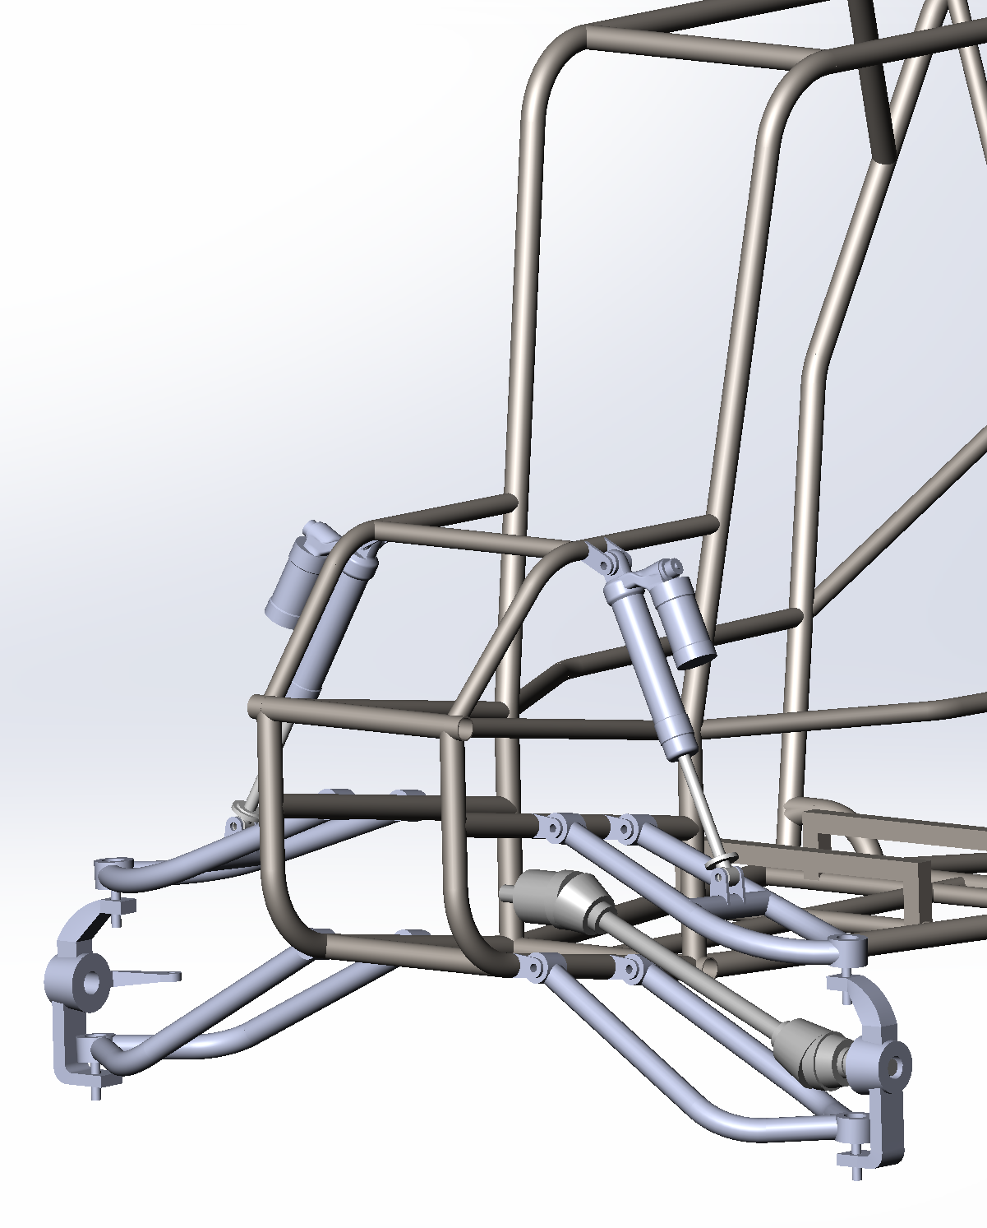
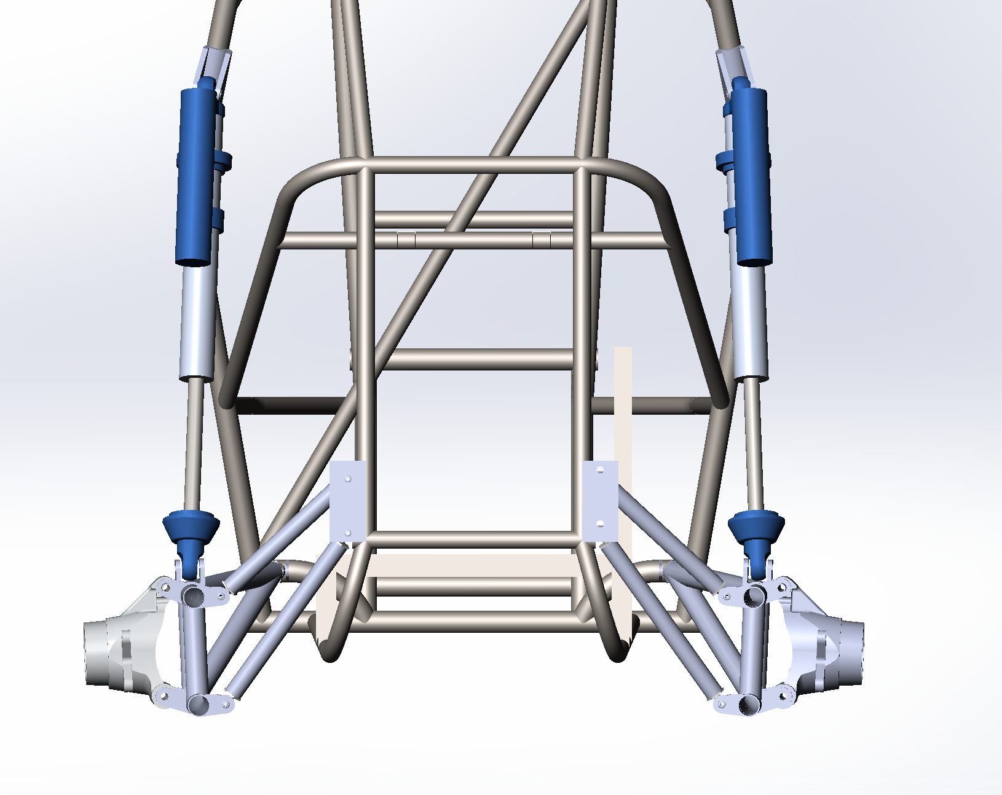
Suspension Mounting Points
Both the front and rear suspension needed to be attached to the chassis via the control arm locations and the shock mounting points
Front Suspension Mounts
Rear Suspension Mounts
Notes:
the front suspension needed additional tubing to for the front shocks and upper trailing arm and the rear suspension needed free space to be able to move around and an extra bent tube for the front mounting point of the trailing arm

Slide 13
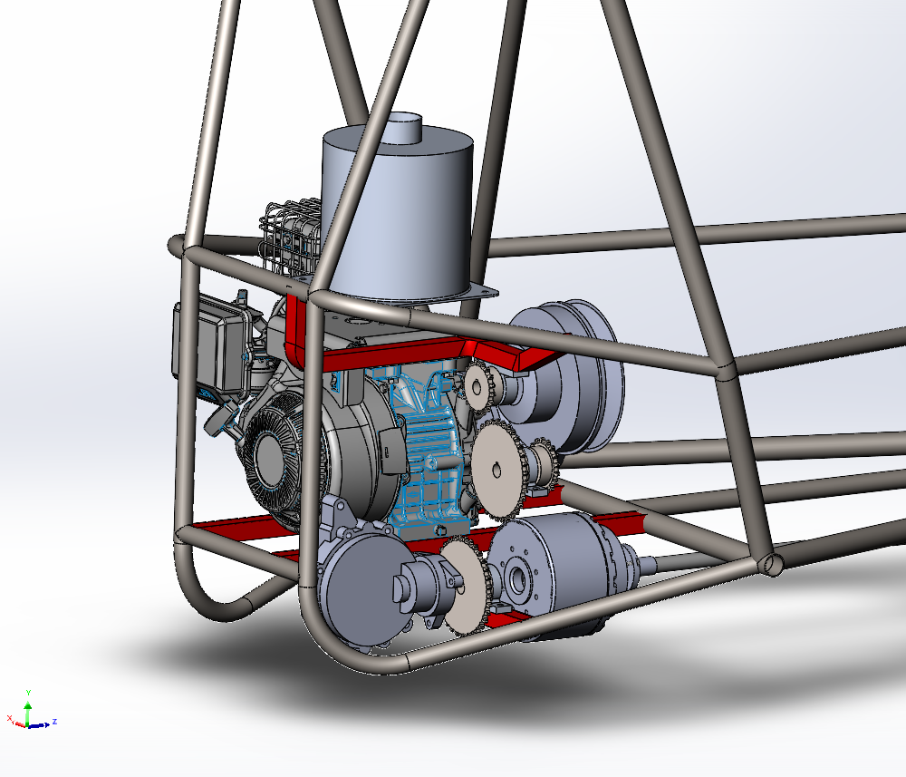
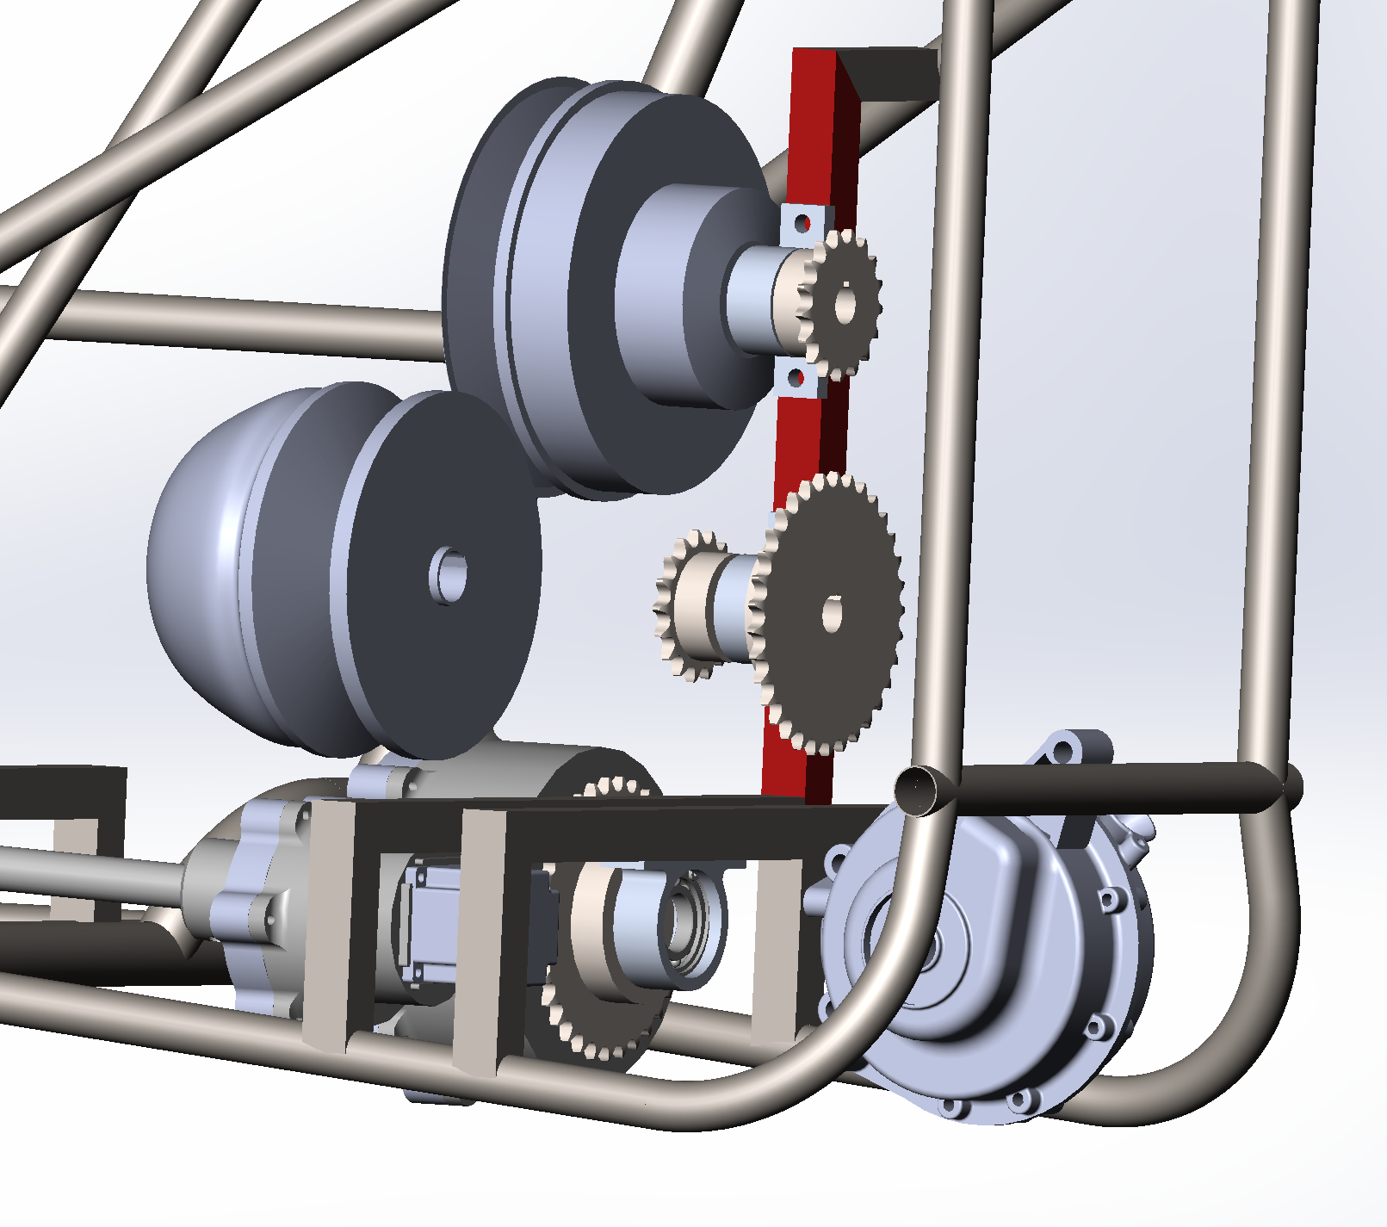
Powertrain Mounting Points
To decrease the amount of tubing that might be needed for the powertrain, the powertrain mounts will all be mounted on a single square tube running up along the chassis (highlighted in red)
Figure 17: Powertrain Mount v1
Figure 18: Powertrain Mount v2

Slide 14
Design Changes
 | Older Model | New Model
Mass (kg) | 31.2 | 27.1
Height (in) | 51.6 | 44.7
Length (in) | 71.3 | 71.3

Slide 15
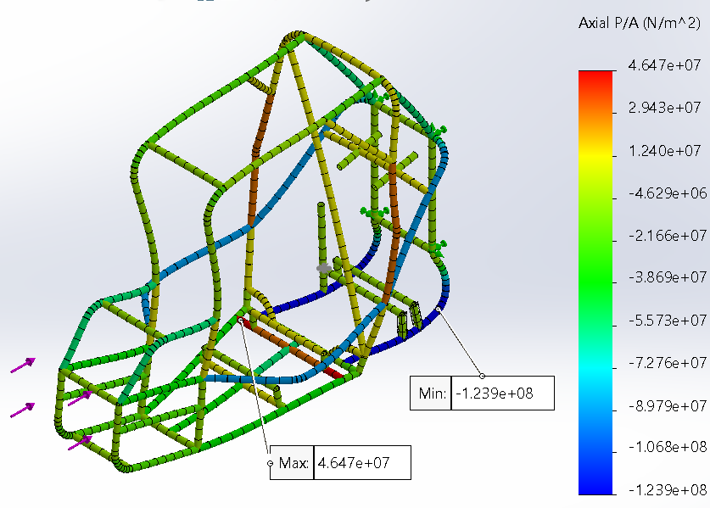
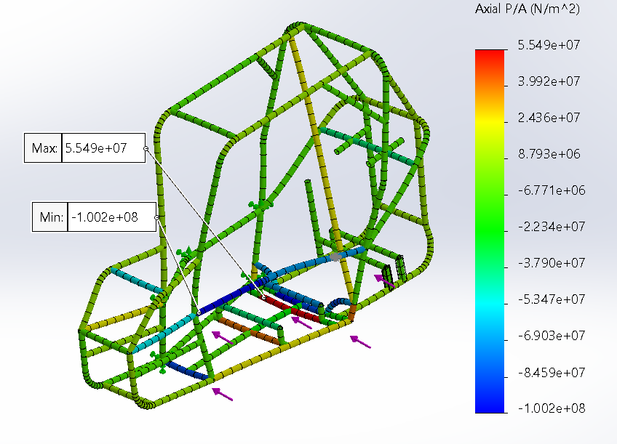
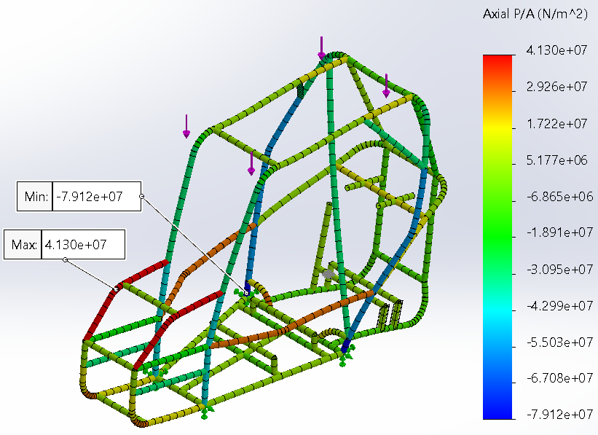
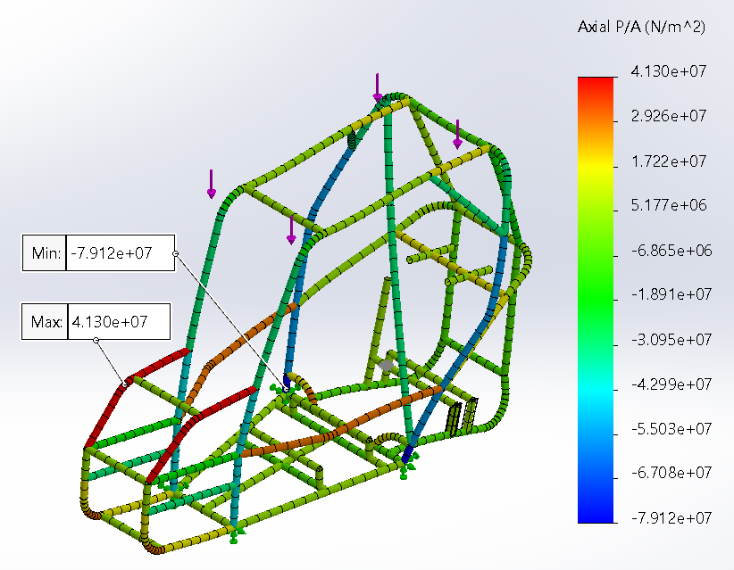
Chassis Analysis
Front Impact
Fixture
Rear Joints
Force
Front Joints
Side Impact
Fixture
Side Joints
Force
Opposite Side Joints
Roll Over
Fixture
Bottom Joints
Force
Top Joints
Rear Impact
Fixture
Front Joints
Force
Rear Joints
Notes:
Preparation of Model
Midsurfacing, suspension points

Slide 16
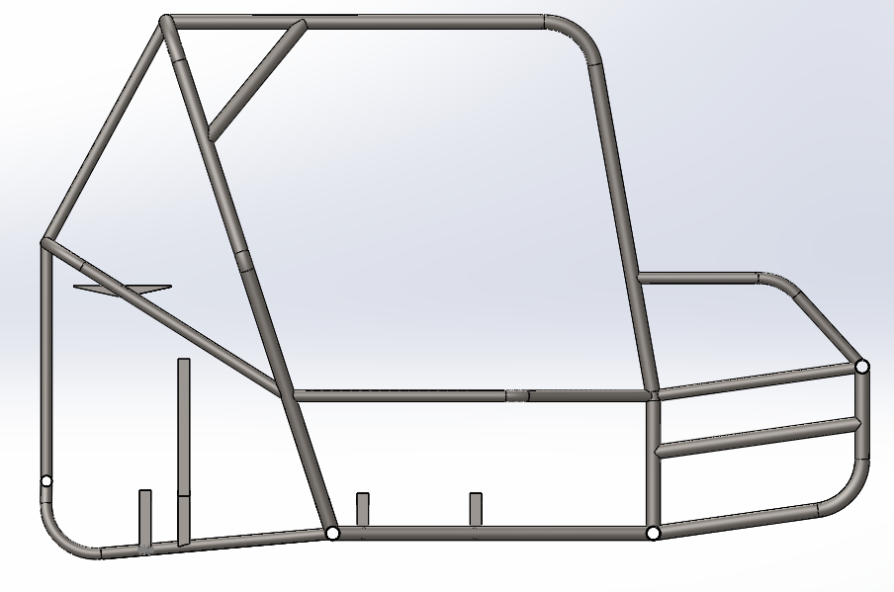
Issues with FEA Singularities
Improper constraints due to Solidwork’s only allowing boundary conditions at weldment joints for 1D studies
ANSYS 2D studies showed similar stresses near the weld joints, and trying to include weld fillets ruined mesh topology
Chassis should still be able to withstand impact forces as rulebook forces a strong and robust design, especially paired with 4140 alloy steel.

Slide 17
Front Suspension
And Steering

Slide 18
Design Goals and Challenges
Front Suspension Goals:
Induce oversteer characteristics
Minimize and Linearize Bump Steer and Camber angle in bump and droop scenarios.
Reduce Unsprung weight
Steering Goals:
Get Ackerman Steering rating close to 100%.
Reduce Unsprung weight
Challenges:
Knuckle and Chassis Hardpoints made it difficult to obtain good Near 100% Ackerman rating and minimize and linearize bump steer and Camber angle changes

Slide 19
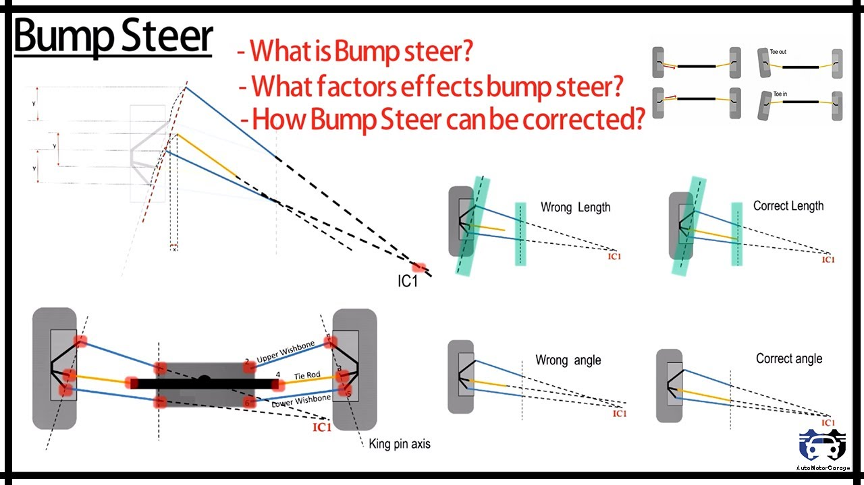
Bump Steer
Bump Steer: Toe change during wheel travel.
The upper control arm, lower control arm, and tie rod follow different arcs.
To correct bump steer draw lines from the outer ball joints of the upper and lower control arms and then extend these lines until they intersect.
Intersection point is the Instantaneous Center.
Tie rod should intersect with the Instantaneous center.
Having inner ball joints of upper and lower control arms on the same vertical plane greatly reduces bump steer because the arms will follow the same path in a bump.
Ideal Bump Steer Characteristics

Slide 20
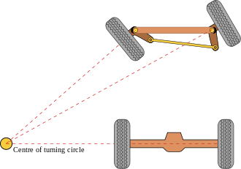
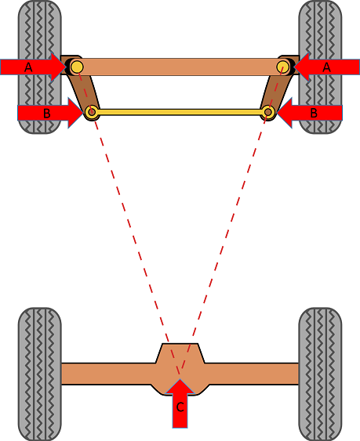
Ackerman Steering
Ackerman steering is used to combat the problem wheels traveling at different rates presents.
What does ackerman percentage mean:
<100% Ackerman : inside tire is trying to push/roll/slip Out of the turn. (Understeer)
100% Ackerman : inside tire rolls smoothly along turn
>100% Ackerman: inside tire is trying to pull/roll/slip Into the turn. (Oversteer)
Ideal Ackerman Geometry

Slide 21
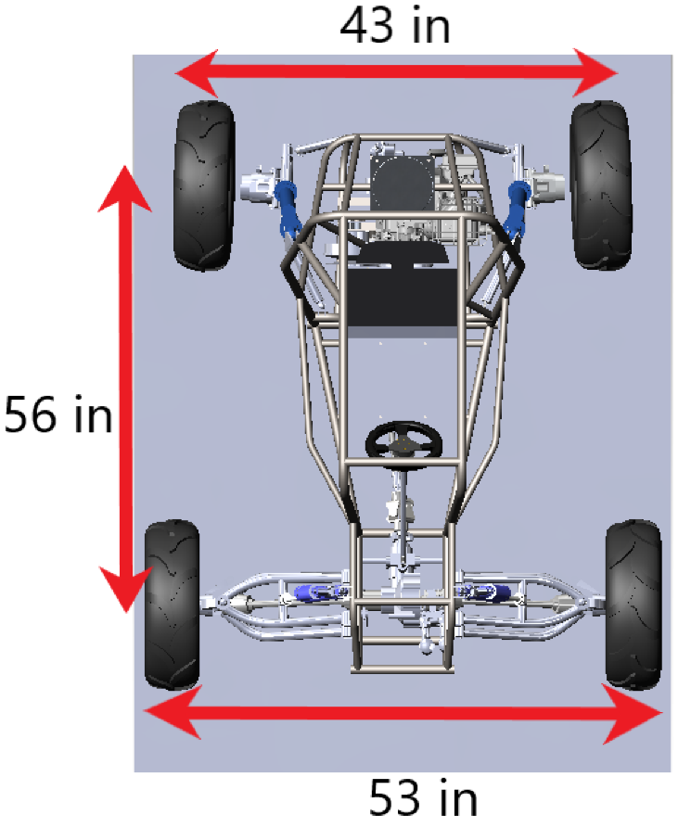
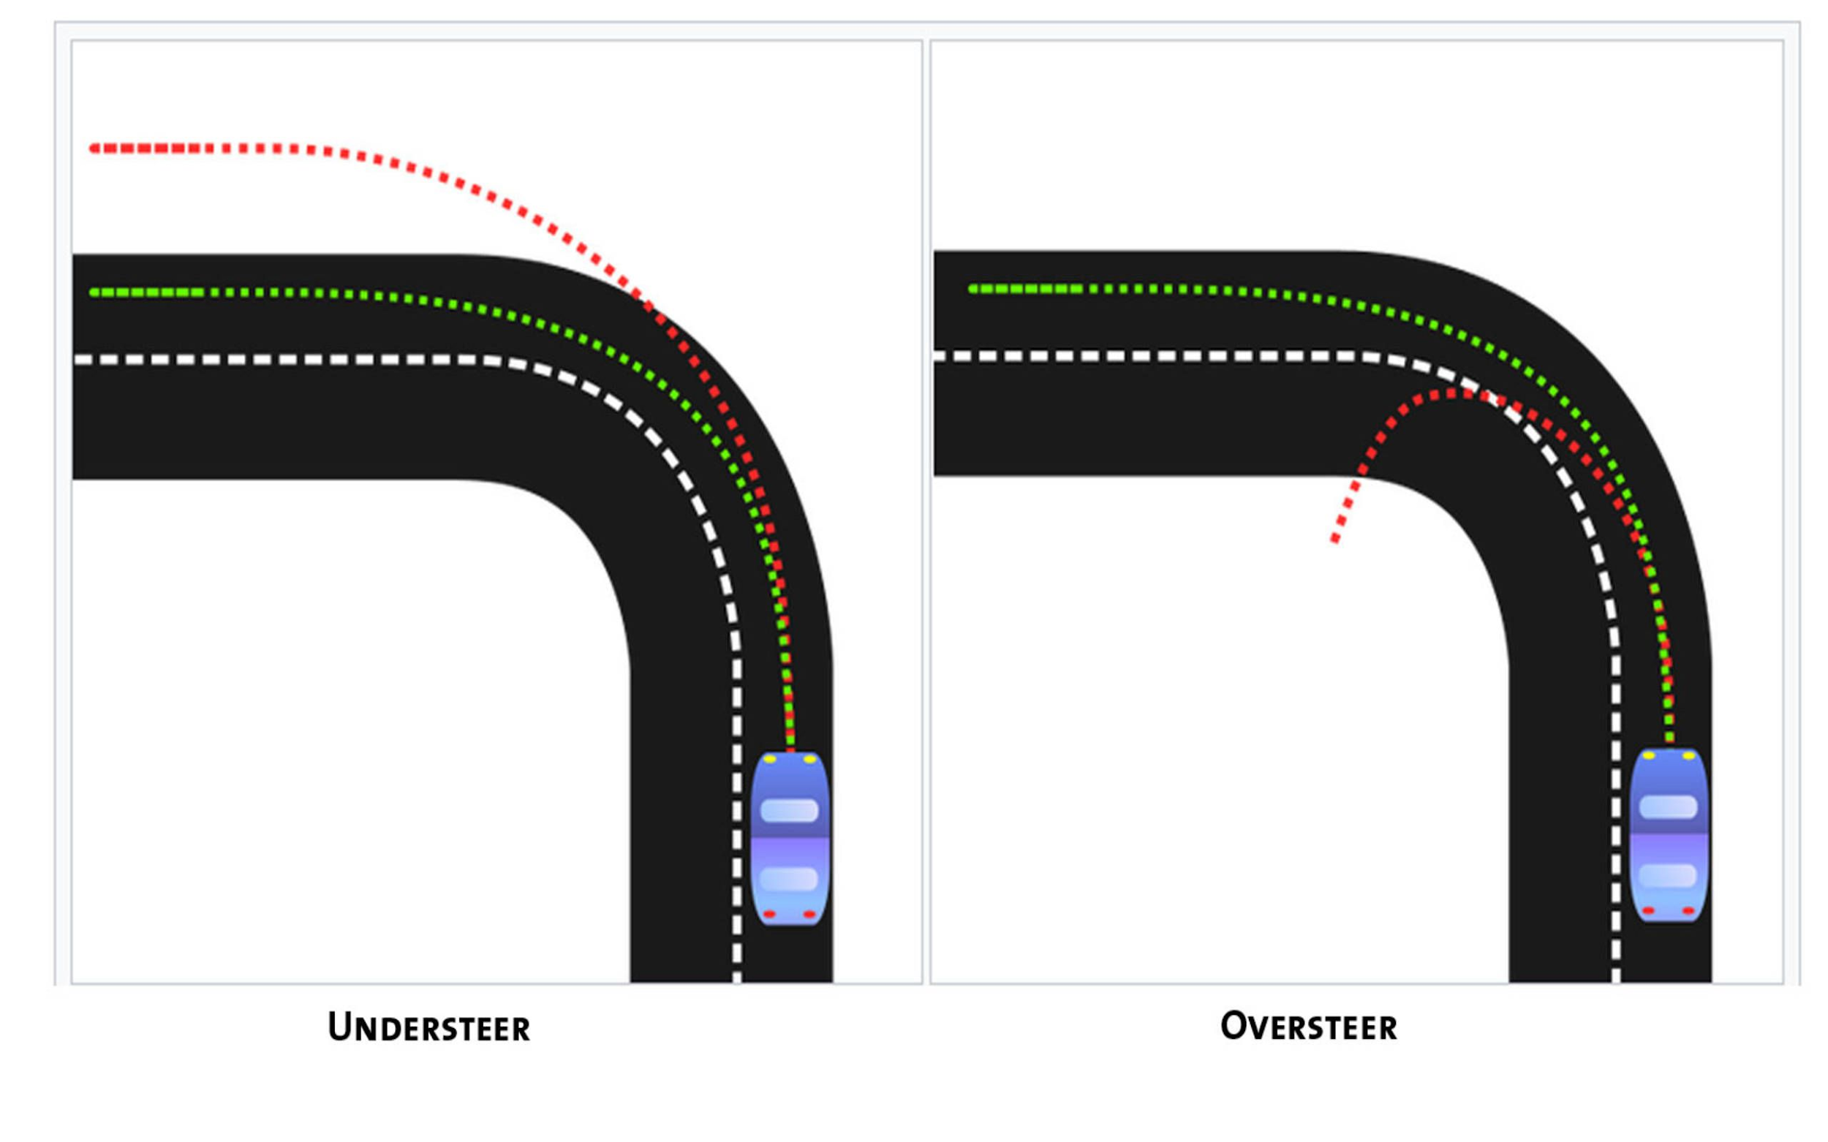
Inducing Oversteer Characteristics
Basic vehicle dynamics: The wider the track, the lower the amount of weight transfer.
If you only widen at one end, then that end will gain traction and the other will not which changes the handling balance.
Result: Widening the front track will give the vehicle more front traction which will make it less prone to understeer.
Tire Locations

Slide 22
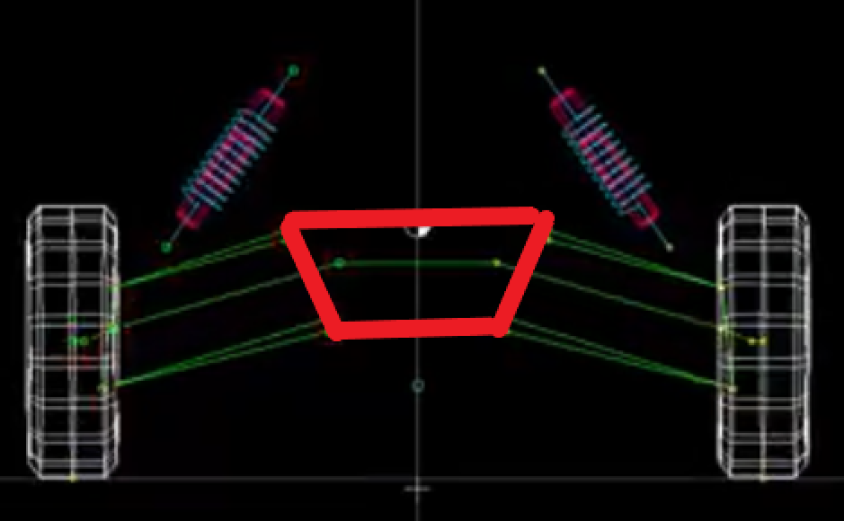
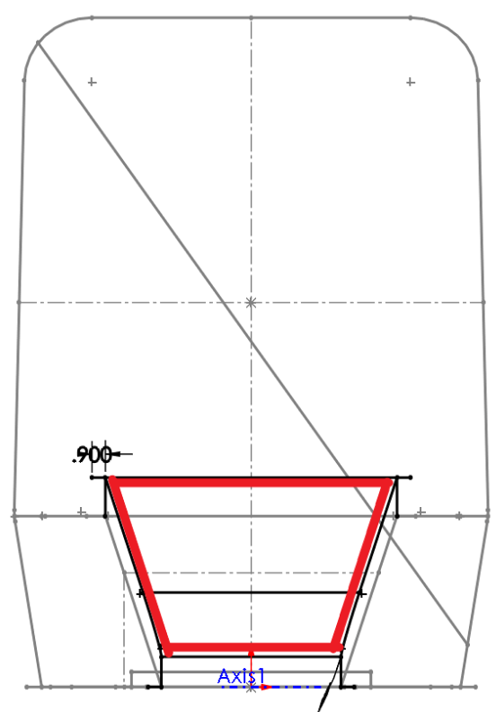
2020 Design
The front of the frame where the control arms will be mounted was shaped like a trapezoid.
This was not ideal for having a suspension geometry with low and linear bump steer.

Slide 23
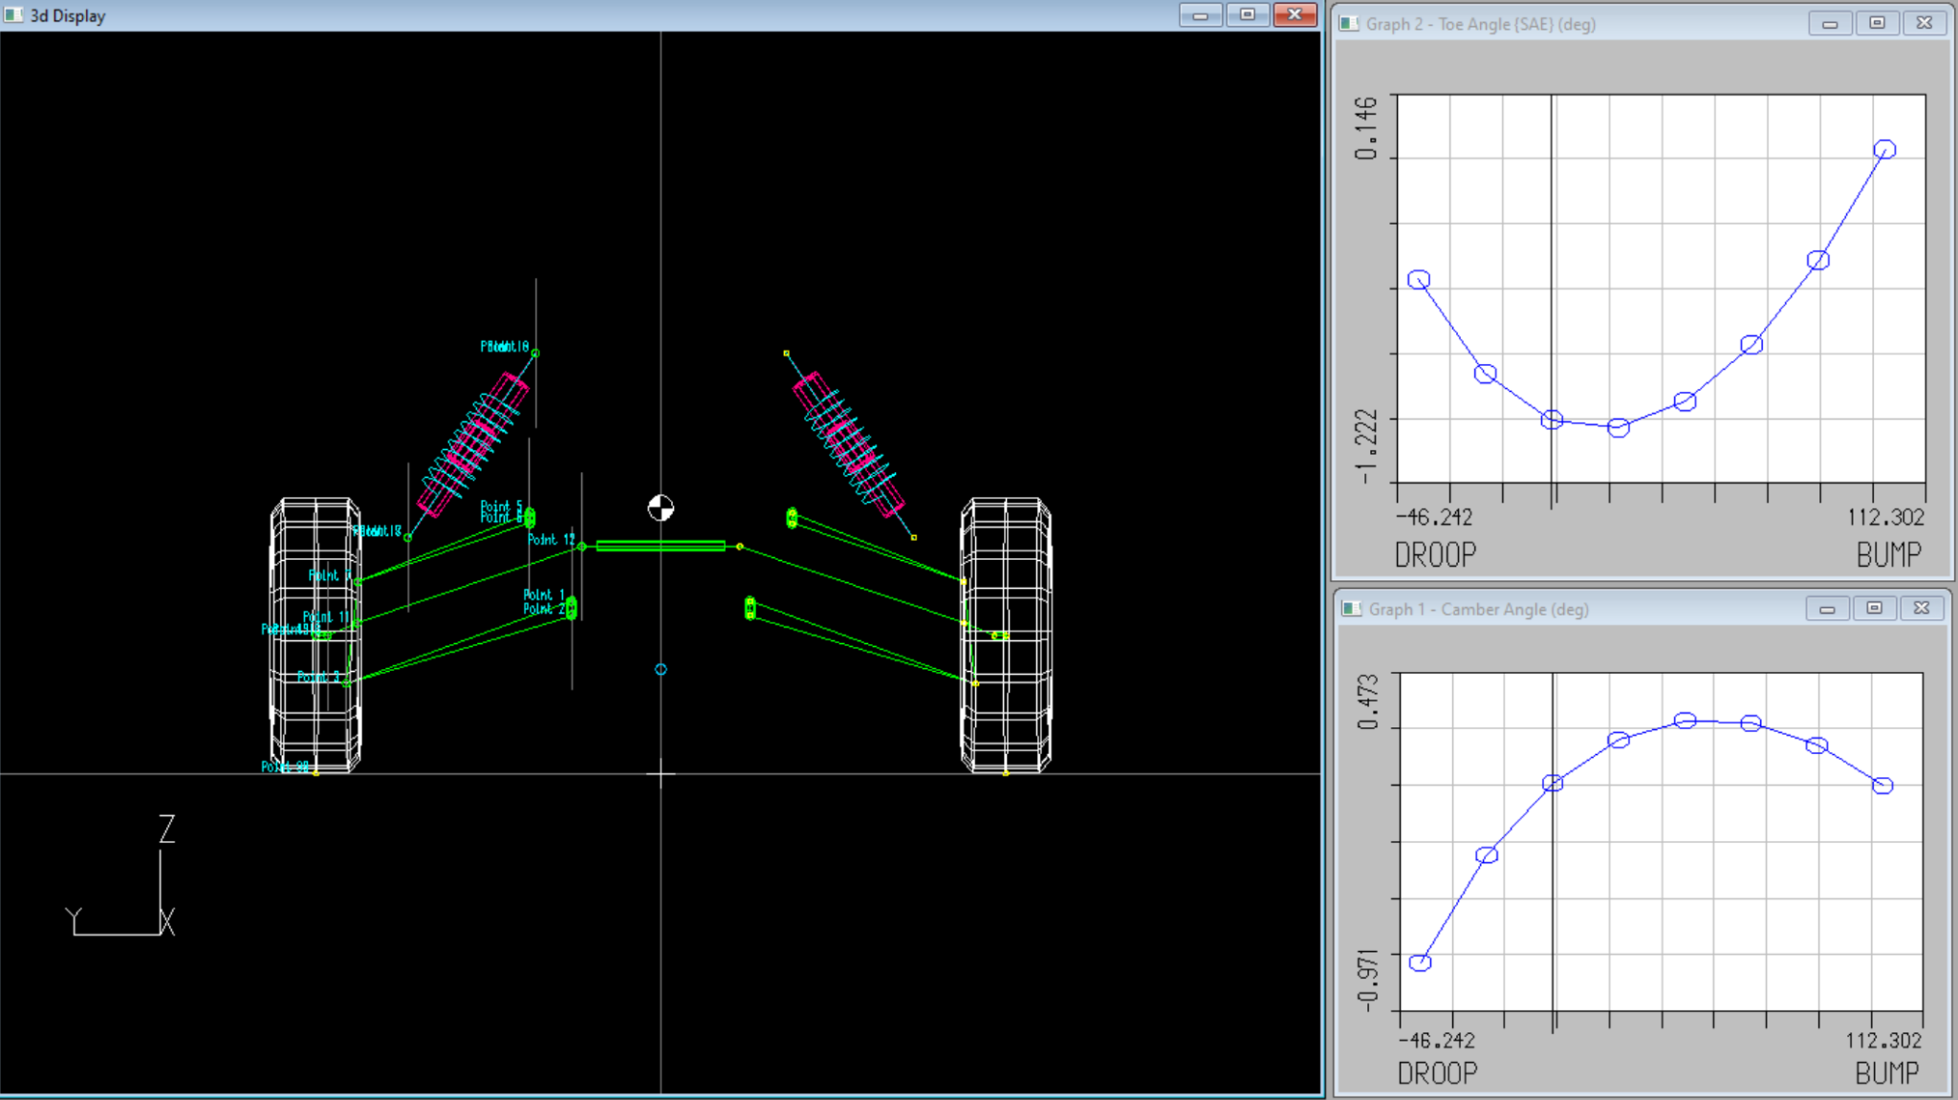
2020 Lotus File

Slide 24
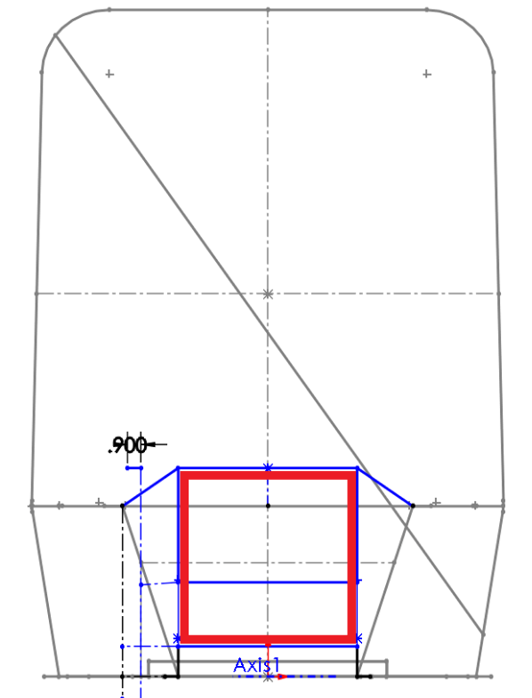
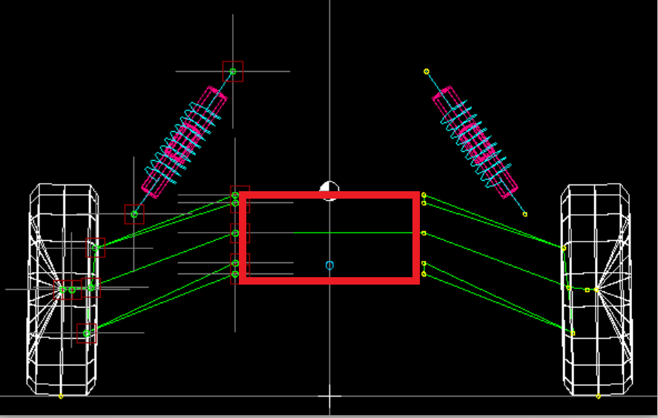
Semi-Final Iteration
The front of the frame was modified to be rectangular.
This allowed the upper control arms to be mounted directly above each other, allowing for low and linear bump steer.

Slide 25
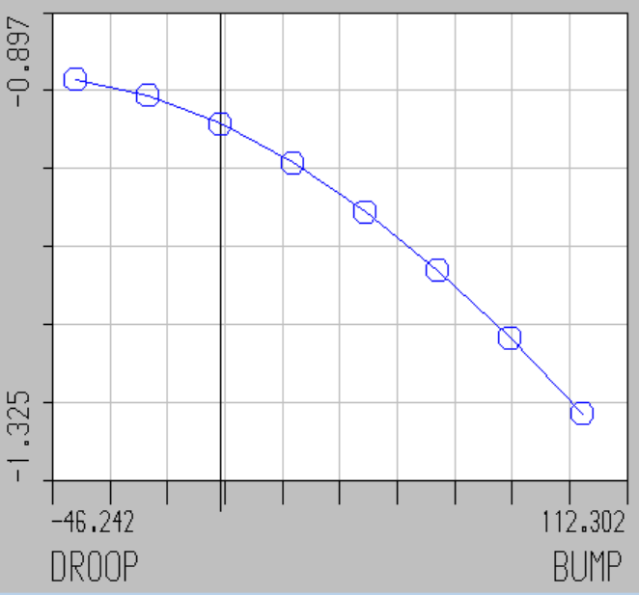
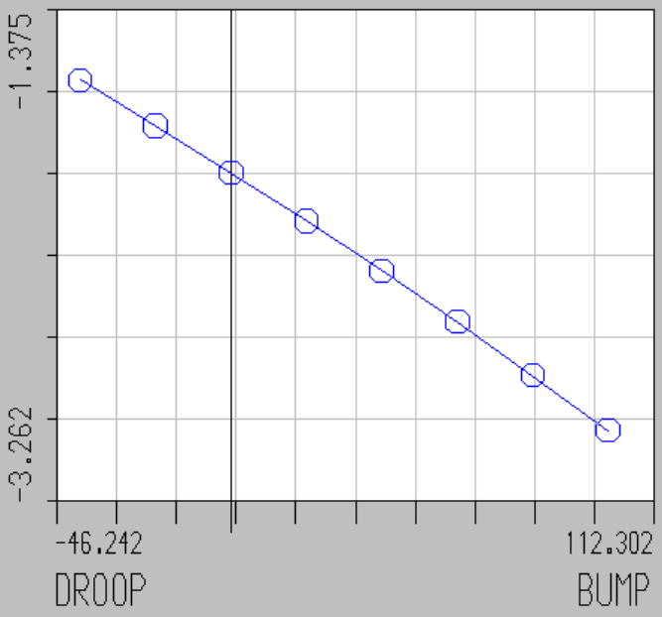
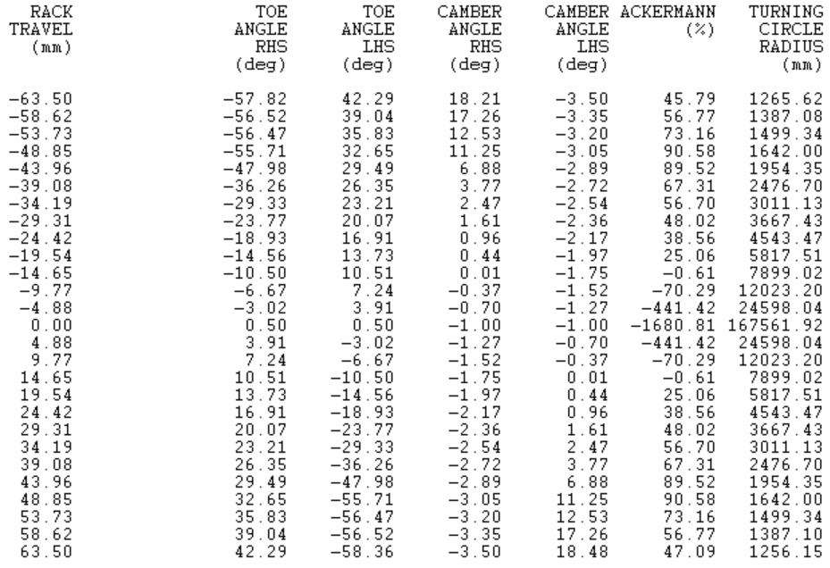
File that Prioritized Steering
Ackerman Steering - Steering
Toe Angle - Steering
Camber Angle - Steering

Slide 26
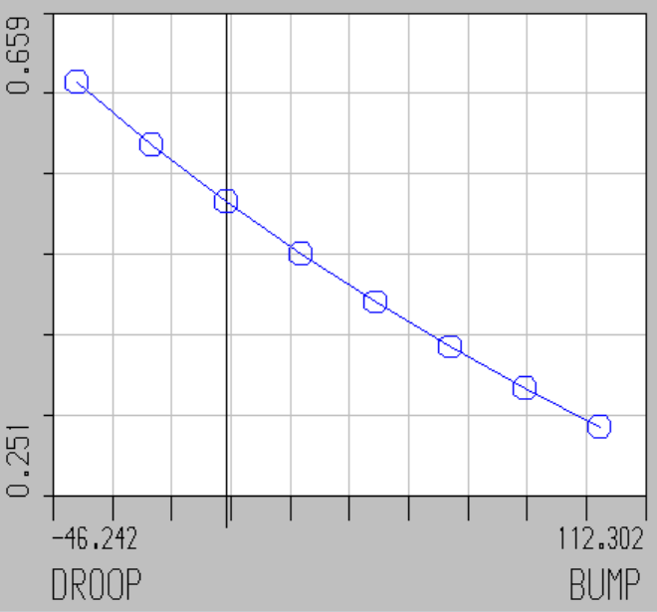
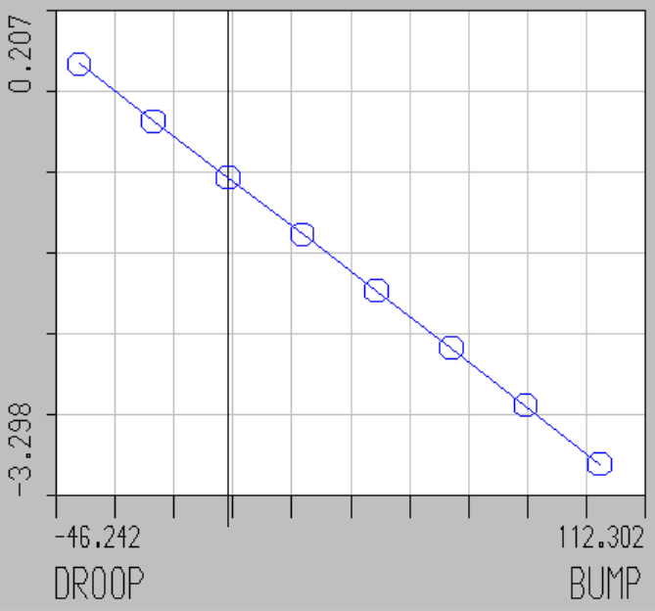
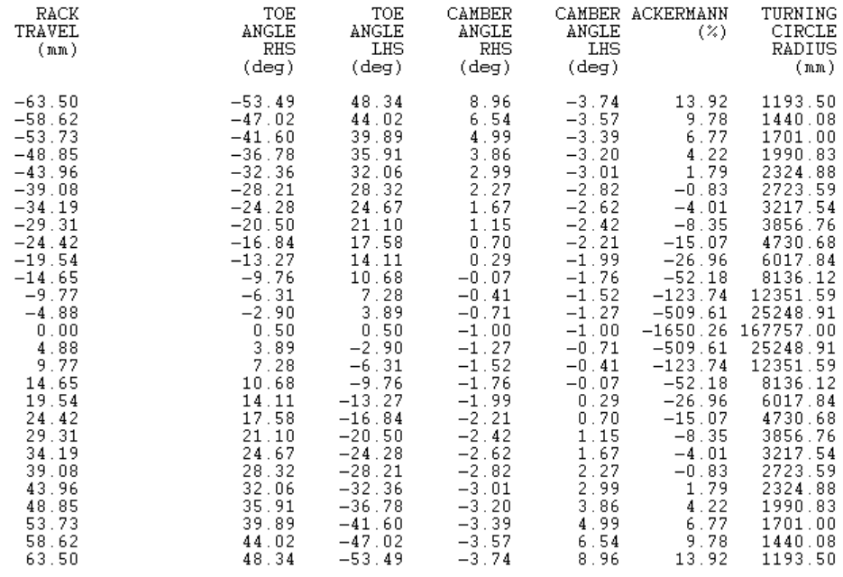
File that Prioritized Suspension
Ackerman Steering - Bump Steer
Toe Angle - Bump Steer
Camber Angle - Bump Steer

Slide 27
Knuckle Decision Matrix
 | Cost | Manufacturing | Handling | Weight | Total | Weighted Total
Score Weight | 0.8 | 0.8 | 1 | 1
Current | 9 | 9 | 4 | 4 | 26 | 22.4
New | 5 | 5 | 9 | 9 | 28 | 26

Slide 28
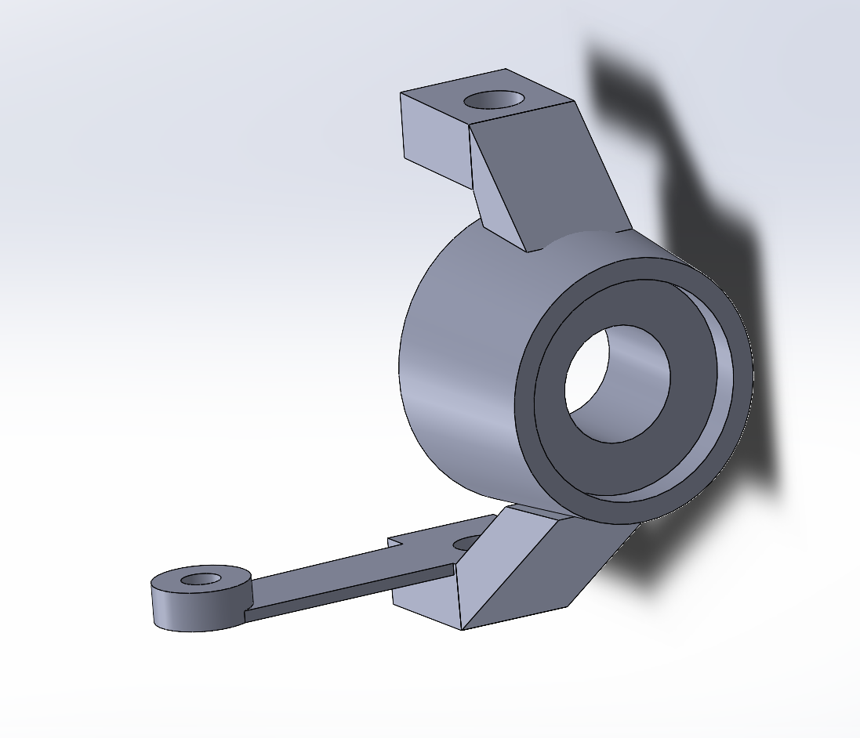
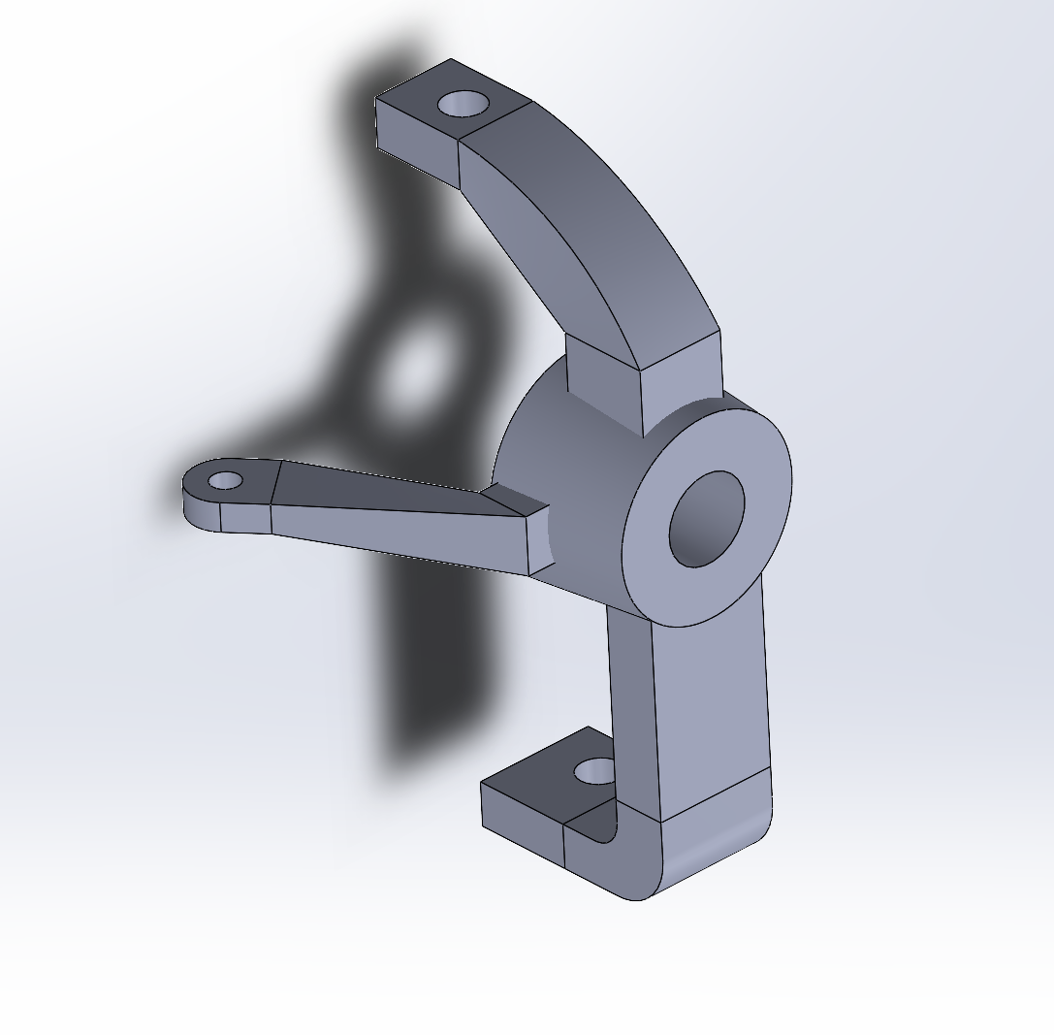
Knuckle Analysis
The knuckle was changed in order to accommodate new points on LOTUS.
The current CAD file for the knuckle was a basic model that used points on an off the shelf cast-iron knuckle
The new knuckle would have optimized points for the A-arm mounts and would be made of aluminum instead of cast iron to improve weight characteristics
Old Knuckle
New Knuckle

Slide 29
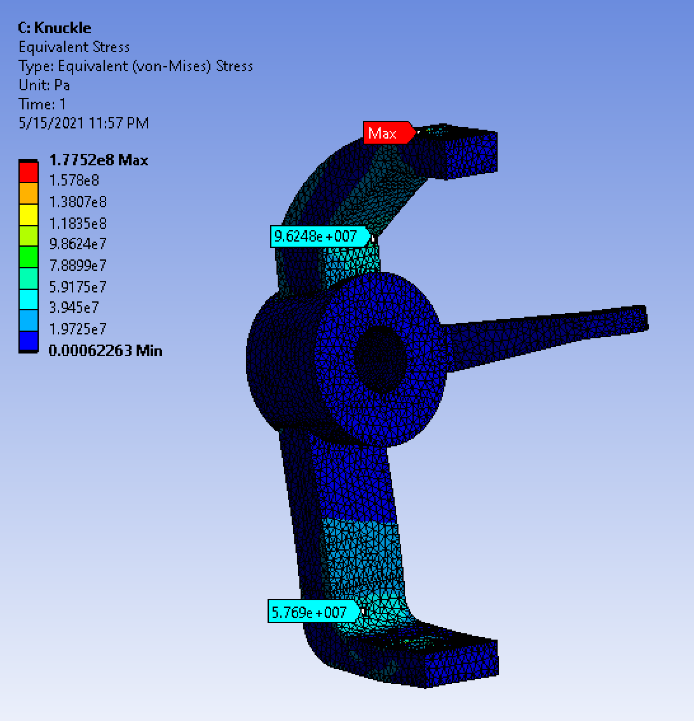
FEA Analysis
The new knuckle needed to be stress tested to ensure it would handle the stresses of an impact equaling 10 kN of force
With a yield stress of 276 MPa, 6160 Aluminum Alloy was chosen as the material because of its machinability and cost.
A max stress of 96 MPa was found near the fillets of the knuckle giving our knuckle an effective safety factor of 2.875
Knuckle Results

Slide 30
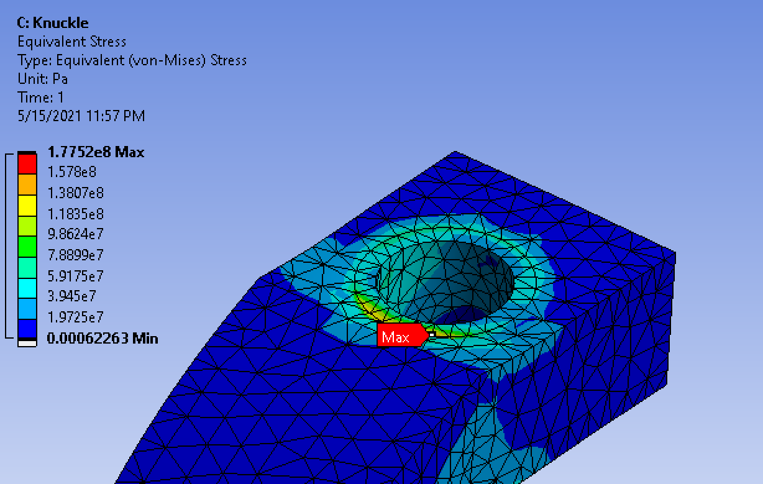
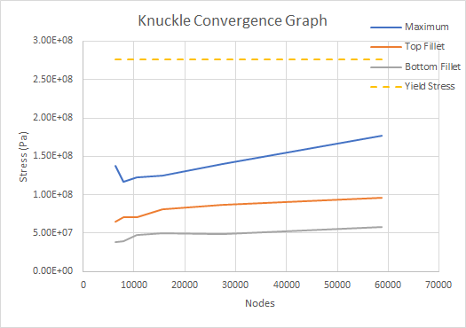
Knuckle Convergence Graph
The divergence seen can be ignored because it is on a bolt constraint, which generally isn’t a place where knuckles would fail. On top of this, the stress is located directly on the boundary constraint meaning that St. Venant's Principle can be used to ignore the stresses in the area.
Singularity on Bolt
Knuckle Convergence Graph

Slide 31
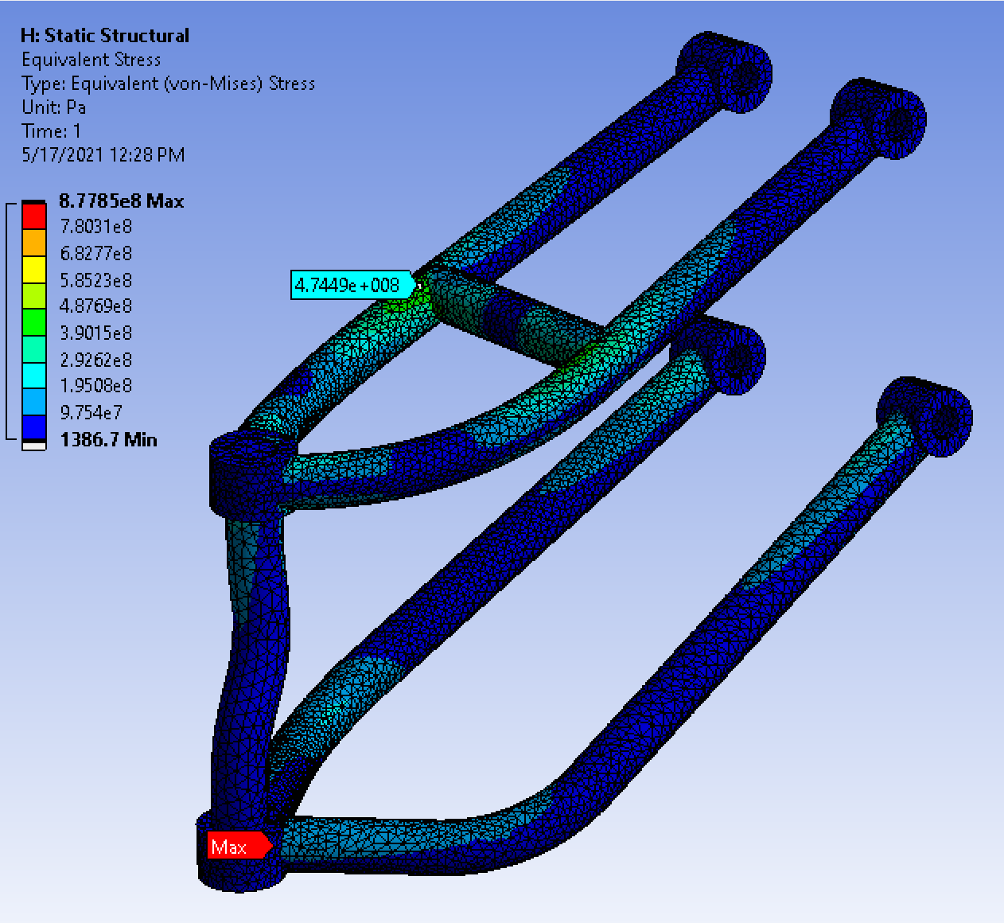
A-Arm FEA Analysis
A-arms converged to a stress of 474 MPa ignoring singularities.
The usual steel we purchase (4140) has an annealed yield stress of 435 MPa, which would mean the part would yield from an impact caused by falling from 5 feet
4140 can be heat treated to achieve better yield strengths
A-arm stress locations

Slide 32
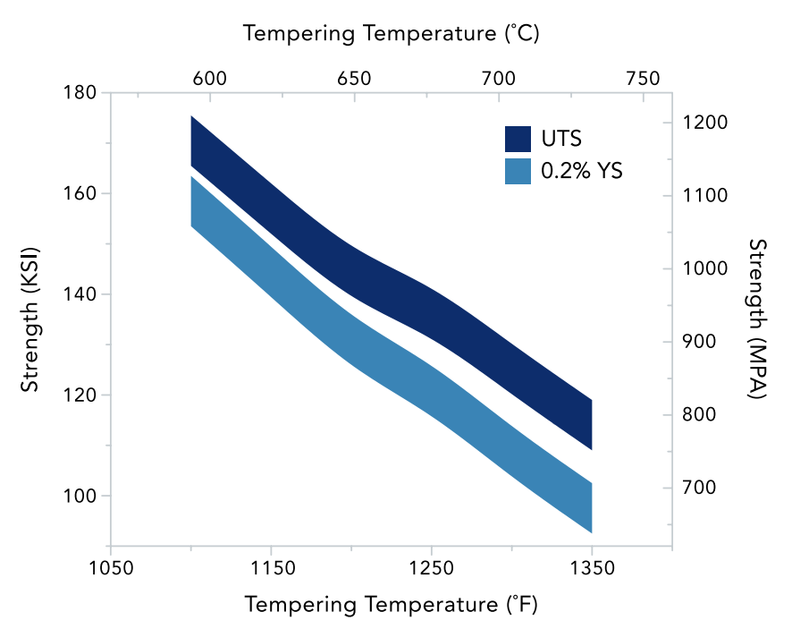
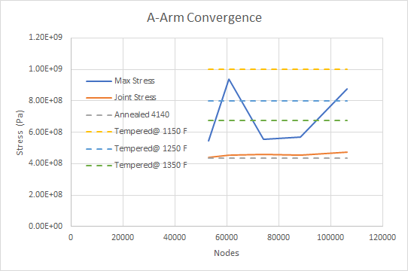
A-Arm Convergence Graph
Yield Stresses relevant for if steel is austenitized at 1625°F (885°C) and water quenched, then soaked at temper temperature for approximately 60 minutes
Temper Temp vs. Yield Strength Graph
A-arm Convergence Graph

Slide 33
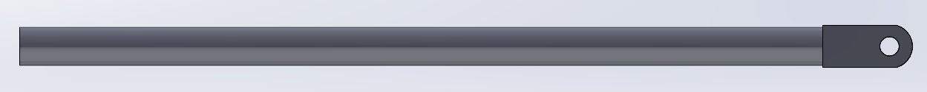
Tie Rods
Creating a new knuckle allowed for the tie rod to be shortened.
This is because the tie rod mounting point on the new knuckle is closer to the chassis than the old knuckle.
New Tie Rod is 430mm (16.9291 in) long and is made of 4140 Steel.
The tie rods will experience compression and tension forces when in use.
Tie rod

Slide 34
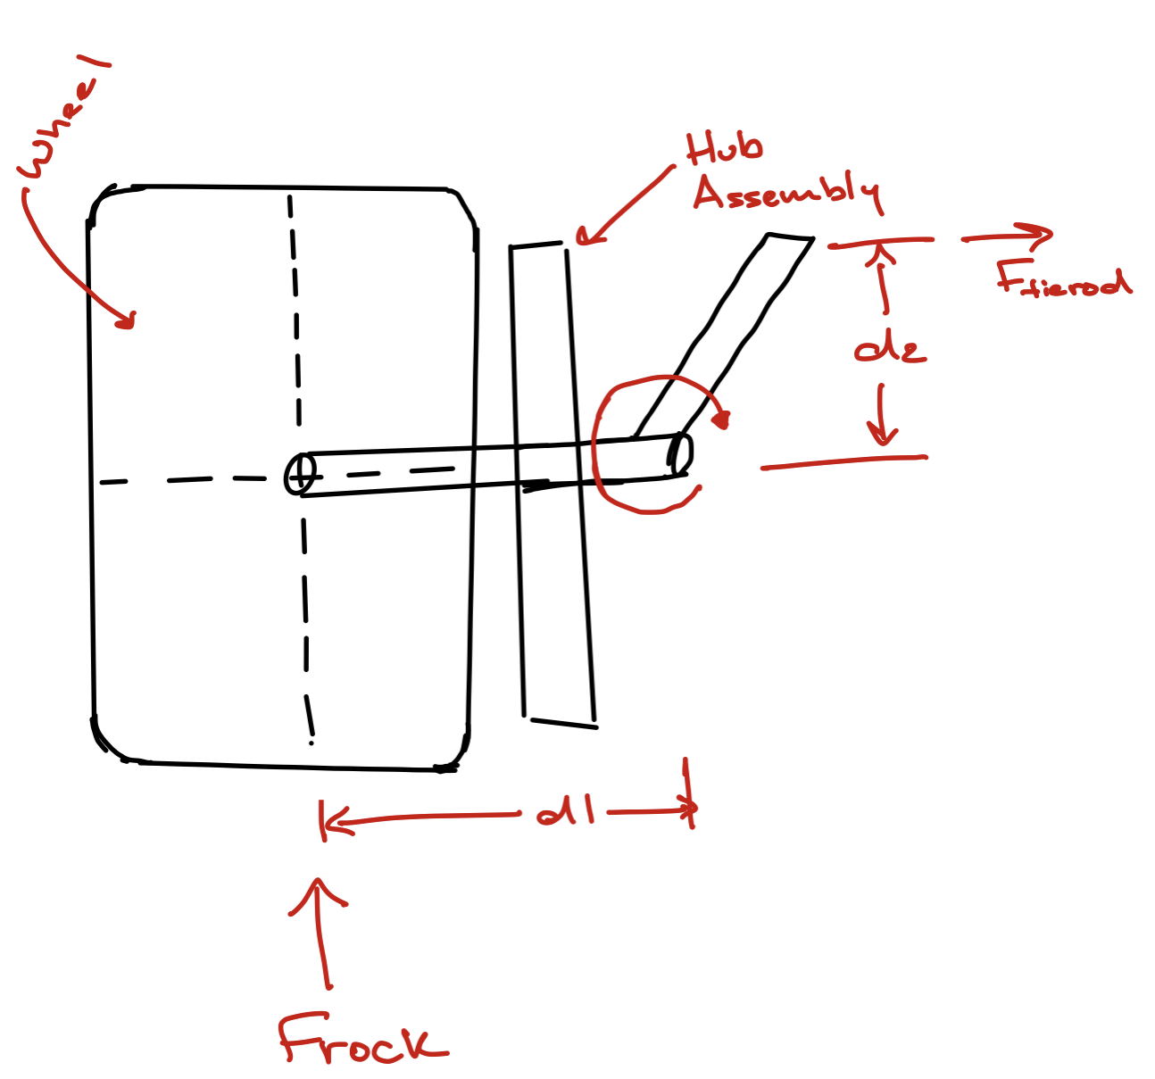

Tie Rod Calculations

Slide 35


Tie Rod Compression FEA
Convergence graph for stress in compression
Stress of tie rod in compression

Slide 36

Tie Rod Tension FEA
Convergence graph for stress in tension
Stress on tie rod in tension

Slide 37


Camber and Toe Angles
Change in Camber Angle with respect to bump and droop
Change in Toe Angle with respect to bump and droop

Slide 38

Ackerman Rating
When the steering wheel is at “full lock” an Ackerman rating of 95.24% is achieved.
Final Ackerman Settings

Slide 39


Shock Mounting
This years BAJA is 4WD
Axle Shaft ( Circled in Green) runs between the Upper and Lower A arms.
Eliminates possibility of mounting the shocks to the lower A- Arm.
Adding the shock mounting point to the upper A arm raises the mounting point for the shock on the chassis.
Tubing (Circled in Red) was added to the front chassis for the shocks to mount on were added.
Shock Mount Location

Slide 40

Bill Of Materials

Slide 41


Front View: LOTUS and SolidWorks
Lotus/SOLIDWorks Comparison

Slide 42

Goals Achieved
Having the tracks width wider in the front than in the back induces over steer characteristics.
Designing a new knuckle allowed for better bump steer and Ackerman characteristics
Reduced unsprung weight by using Aluminum instead of Iron for the Knuckle and shortening the tie rods.
Redesigned front of the chassis so that control arm mounting points would lie on the same vertical plane to reduce linearize bump steer.

Slide 43
Rear Suspension

Slide 44

Design philosophy
HOW THE REAR SHOULD AFFECT THE DRIVING CAPABILITY:
Overall goal was to have a more lightweight and nimble vehicle to provide tight cornering during the race, while maintaining traction in the rear.
While steering and cornering is essentially due to the front suspension, over-designing the rear affects the overall performance
Front carries weight of the rear on a turn
Notice the front track width is greater than the rear’s to provide easy maneuverability
AS A RESULT:
Focus on having a shorter wheelbase and a similar track width to aid in the front cornering capabilities.

Slide 45


Updated Design of the Rear
2020 BAJA
2021 BAJA
Figure 47: Previous Year depicting wheelbase/track width parameters
Figure 48: Previous Year depicting wheelbase/track width parameters

Slide 46


Creating Suspension Mounting Points
The new wheelbase and track width parameters were imported into LOTUS SHARK
Figure 49: BAJA 2020 Hard Points
Figure 50: BAJA 2021 Hard Points

Slide 47

Creating Suspension Mounting Points
Visual of LOTUS SHARK hard point translation to SolidWorks CAD model
Figure 51: LOTUS Hard Points
Figure 52: Translation into SolidWorks CAD

Slide 48

Previous Iteration Anti-Squat Flaw
Figure 54: Lotus Anti-Squat graph
Figure 53: BAJA 2020 TRAILING ARM
Heim Joint pivot point too low (Point 1)
Between approx. 4% and -27% anti-squat
UNFAVORABLE

Slide 49


Why is Anti-Squat so Important?
IDLE
ACCELERATION
Figure 55: Depiction of idle suspension set-up
Figure 56: Depiction of suspension set-up in acceleration
While in acceleration, the camber links cause the wheels to tilt, what we call camber. This camber causes less traction on the ground.
Having negative anti-squat can cause the chassis to potentially droop too low, which causes this loss of traction and acceleration.

Slide 50

Mitigation
Inboard= lateral movement towards center of mass of vehicle
Outboard= lateral movement away from center of mass of vehicle
INBOARD
OUTBOARD
Figure 58: 2021 BAJA Lotus Rear Suspension Hard Points
(TOP VIEW)
Figure 57: 2021 BAJA Lotus Rear Suspension
Hard Points

Slide 51


Anti-Squat Parameters Continued:
Point 2 & 5: Upper and lower camber links also dictate anti-squat properties
Finding the vertical “sweet spot”, positioning camber links too low causes too much positive anti-squat
Figure 60: Lotus Anti-Squat graph updated
Figure 59: 2021 BAJA Lotus Rear Suspension
Hard Points
(REAR VIEW)
FINAL: 40% to 7% Anti-squat in bump

Slide 52


New Trailing Arm
Figure 61: Old Trailing Arm
Figure 62: New Trailing Arm

Slide 53

FEA Analysis (Drop Test)
After putting in hard points for the rear trailing arm and creating one, we had to do FEA on the trailing arm.
In an impact scenario of a drop from 2 feet in the air, the impact forces were idealized as roughly 4x the weight of the entire vehicle (10 kN).
Boundary conditions were applied at where the knuckle would mount to the arm, the shock mount, and the front heim joint
Figure 63: ANSYS FEA Trailing Arm

Slide 54


FEA Analysis
Studies converged to a von Mises Stress of 216 MPa, which would give us a safety factor of 1.89 (if we use 4140 Steel).
The maximum stresses were located underneath where the shock mount would be and the study seemed adequate as the impact forces were overestimated.
Figure 65: Trailing arm convergence graph
Figure 64: ANSYS FEA Trailing Arm Stress Allocation

Slide 55

Goals achieved:
Designed a BAJA vehicle that is more smaller and agile
Mitigated negative anti-squat properties to provide greater traction in the rear.
Designed a smaller and lighter trailing arm with a factor of safety of almost 2.
Figure 66: BAJA 2021 Final Rear Suspension Set-up

Slide 56
Brakes

Slide 57



Recap of Previous Brake Design
2020 miniBaja (no brakes)
Notes:
There was NONE - there was no brake assembly, so one from scratch was made we went to CCNY to retrieve any available parts to use as reference to create the whole assembly and one of them being the brake assembly - parts such as the calipers and pads were missing so it was difficult to dimension and create - With the parts of the actual disc and brake a new assembly was designed

Slide 58



Design Philosophy
Front View
Top View
Upside Down Brake Assembly
Front and top view of updated chassis design
Notes:
To reference back to our most current iteration - the front of the chassis was modified to Create more space for the braking and steering system
We maintained the upsdie down brake assembly based on last year’s brake design. Creating comfort and space for a compact design. They support a “heeltoe” approach for pressing on them as opposed to a floor mounted brake that requires the whole foot to press on the brake.

Slide 59

Mounting Constraints
Master Cylinders with seperate mounted reservoirs
Requires external part to convert horizontal movement to vertical movement
Parts can lead to a cluster jam
Vertical is more valuable than horizontal space
13.5” clearance from lower to upper front side of chassis member

Slide 60



Brake Parts
Arctic Cat 500 Rear Brake Caliper (x2)
Polaris Hawkeye 300 Brake Pads
2003 Arctic Cat 500 Hub Assembly
Notes:
In addition to the new brake design, we have in stock the Arctic Cat 500 Front Brake Calipers were already purchased to replace the previous Polaris 500 Brake Calipers from the previous year. The hubs and rotors come from a used 2003 Arctic Cat 500 and this helps mesh the driveshafts easily. Rear calipers remain the same but the old brake pads will be replaced with new sintered pads for a better grip and better resistance to heat.

Slide 61






CAD
Individual brake parts
CAD modes of parts

Slide 62


CAD
Brake Assembly
CAD of Brake Assembly

Slide 63




Brake Pedal Assembly
Final brake assembly CAD format

Slide 64


Updated Design with Brake Assembly
2021 miniBaja (with brakes) FINAL assembly

Slide 65
Updated Calculations
OLD
NEW
NEW (REVISED) | Front | Rear
Torque Needed (N.m) | 472.033 | 176.85
New Torque Generated (N.m) | 1400.1 | 2149.3
New Safety Factor | 2.97 | 12.15
NEW | Front | Rear
Torque Needed (Nm) | 464.48 | 184.85
Safety Factor | 2.97 | 12.15
Table 1: Torque needed, generated, and safety factor
Table 2: Torque needed, generated, and safety factor

Slide 66



Brake Calculations
Notes:
Updated brake calculations with new total mass of 240 kg
Last year’s design was around 270 kg 272 kg
These safety factors are acceptable since we were very conservative in the assumed numbers for calculating the generated torque and assumed the extreme case scenarios for the numbers applied while calculating the required torque.
MATLAB was utilized to calculate the braking force. Equations were used to construct the MATLAB code necessary for the brake force calculation and the other variables necessary for the Rotor and Disc Selection.
it is composed utilizing M-File for discovering elements raise pivot and front hub powers (Normal reactions) as for vehicle speeding up in 'g' units. A plot is acquired for back hub and front hub powers (Vs) Vehicle deceleration. We also include the , vehicle load and other vehicle geometry are entered as inputs, the magnitude of the forces plots will be further explained when the brake is finalized after conducting a heat analysis report in the near future

Slide 67

Calculations continued…..
Master Cylinder Bore = 19.05mm (3/4 “)
Area= 0.000284 m^2 = 0.44in^2
Front Caliper Area = 1019.34 mm^2
Rear Caliper Area = 793.55 mm^2
Pedal Force = 130 lbf = 578.2665 N
Pedal Ratio = 6:1
Brakes Leverage efficiency= 0.8 (assumed value)
Fmc = 2775.68 N
Pmc = 9773518.31 N/m^2
Front and Rear Force on Calipers
Frc = 30220.978 N
Ffc = 27389.3935 N
Force on Disk
Fdr = 5909.36 N
Torque Generated in the Front
Tgf = 669.6 Nm
Forces on Braking System
Notes:
Existing dimensions -
The formation of the wheel braking force in the tire tread area as a result of the driver exerting a foot force along with the accompanying internal forces is shown in the figure.
The foot force FF applied by the driver is initially multiplied by the brake pedal leverage into the input force for the control device, the control force Fcon. The transmission device, which in this case is hydraulic, converts the control force which is possibly supported by a brake booster which amplifies it further, into the auxiliary force Faux which is in turn transferred as hydraulic pressure to the master brake cylinder. The brake force reaches the wheel brake cylinders via the brake lines and forms the clamping force Ft required for operating the wheel brakes. The clamping forces cause a circumferential force Fper over the friction linings at the effective braking radius r and thus a wheel brake force FBwheel in the tire tread area.

Slide 68

Goals Accomplished
Increase the mechanical advantage and improving the comfort for the driver when using the brake pedals as well as the gas pedal
Reducing total cost but using inexpensive materials and utilizing older parts from previous braking assemblies
Make the braking system more compact
Finalize the braking system for testing
Follow the guidelines and rules in the 2021 SAE Baja regulations
Pedal must withstand 450lbf - 2000N
Wheel must be lock when braking force is applied
It should include at least 2 independent hydraulic circuits
Notes:
Other than not having all the parts, we managed to create a successful brake assembly - the brakes in the rear and front might possibly differ in the future design as it sets slightly different in the rear

Slide 69
Electronics

Slide 70

Electronics-Nissan’s ATTESA-ETS System
Power Transfer to Rear Axle
Multi-Plate Wet Clutch Patch
Power Transfer to Front Axle
Hydraulic/Electronic Unit
G (acceleration) Sensor
Electronic Control Unit (Code)
TP (Throttle Position) Sensor
Notes:
Before I start, if you have any questions during my presentation, feel free to interrupt me anytime, and I’d be happy to answer them.
So for my part of this project, I was the electronics lead where we wanted to implement AWD by utilizing Nissan’s ATESSA-ETS AWD system. This system works by having the engine always supplying power to a gearbox that’s transferring this power through a differential system and eventually transfer torque to the back wheels. A multi-plate wet clutch is designed and used to transfer a percentage of this power from the engine and supply torque to the front wheels whenever this clutch is activated. Activation is dependent on the data acquisition sensors such as the accelerometer and TP (or throttle position) sensors. So basically whenever the sensors tell us that the rear wheels are slipping or the driver is making a sharp turn, control unit turns on the clutch system and sending power and torque to the front wheels.

Slide 71


Performance Incentives, Safety, & Reliability
Helps prevent unwanted loss of grip on low traction surfaces
Limits power loss by not always being in AWD mode
Reduces overall wear and tear on powertrain components
Prevents excessive over/understeer while cornering during a race
Notes:
Some of the reasons why we wanted this AWD system is to
Helps prevent unwanted loss of grip on low traction surfaces
Limits power loss by not always being in AWD mode
Reduces overall wear and tear on powertrain components
And most importantly, to prevent excessive over and understeering while cornering during a race.

Slide 72


Clutch Pack - Torque Transfer Diagram
Notes:
Just a reminder of how the AWD system works: We have the input shaft connect to the engine coming into the clutch pack, and a percentage of this torque is transferred to the output shaft, depending on the amount of compressive normal force. We can see that the Torque output can only be less than or equal to the torque input, and that the torque output is proportionally related to the compressive normal force on the clutch plates.

Slide 73


Clutch Pack - Torque Transfer Theory
Source: https://x-engineer.org/automotive-engineering/drivetrain/coupling-devices/calculate-torque-capacity-clutch/
Notes:
This and the next slide basically illustrates the derivation of getting a formula for how much normal force would be needed to transfer between 0 and 100% of the input torque from the rear shaft to the front shaft

Slide 74


Clutch Pack - Torque Transfer Theory
Source: https://x-engineer.org/automotive-engineering/drivetrain/coupling-devices/calculate-torque-capacity-clutch/
Notes:
Here is a continuation of the derivations of the theory.

Slide 75

Clutch Pack - Torque Transfer Theory
Notes:
Ultimately we get an equation for the maximum force needed, which is approximately 450 lbs for 100% torque transfer from the input shaft with the given values.

Slide 76


BMW’s XDrive Clutch System
BMW XDrive Clutch System
Our Clutch System
Notes:
In order to activate the clutch pack and the AWD, we used BMW’s X-Drive System into our design. The ultimate goal is to create a downwards force onto the pressure plate that lays on top of all the steel and friction disks in our design. In order to do that, we needed to use 2 different types of mechanical advantage systems, a lever arm and a rotating CAM plate.

Slide 77

BMW’s XDrive Clutch System: How It Works
Pressure Plate
Shaft
Lever Arm
Ball Bearing
(Force Actuation)
CAM Plate
Planetary Gearbox
Fulcrum
Pin
Steel & Friction Plates
Clutch Basket
Shaft Bearing
Stepper Motor
Notes:
So basically how it works is that we have a stepper motor that provide around 100 N-centimeters of torque. This torque is then amplified by using a planetary gear box system that reduces angular speed and increasing the output torque onto the CAM plate. As this cam plate rotates, it marginally increases the height of the lever arm and provides a mechanical advantage about the fulcrum pin to put pressure onto the top of the pressure plate. So as the motor rotates, the CAM plate rotates and applies a downwards force onto the pressure plate to compress the steel and friction disks in the clutch basket, transferring a percentage of the incoming torque from the rear shaft into the front shaft, and consequential to the front differential.

Slide 78

XDrive Clutch CAM System (Sectional View)
Notes:
Here is a closeup of the sectional view of the Clutch Activation System.

Slide 79

XDrive CAM-Lever Arm Actuation (Sectional View)
Notes:
This slide basically shows how the system works. As the motor provides torque onto the shaft of the planetary gearbox, the CAM plate rotates and slightly increases the height of the right side of the lever arm and decreases the height of the left side of the fulcrum, providing a higher output of force using this mechanical advantage.

Slide 80


Lever Arm Mechanical Advantage
Lever Arm Measurements
Notes:
So there are two types of mechanical advantage here. The first one is a lever arm system that increases the output force onto the left side of the fulcrum. From our previous calculations, we know that we need a normal force of 450 lbs onto the pressure plate, which is on the left side of the fulcrum. By using this mechanical advantage, we would only need around 142 lbs of upwards force on the right side of the lever arm.

Slide 81



Cylindrical Ramp Mechanical Advantage
T₂
F_{f}
F_{Normal}
Notes:
The CAM Plate’s Cylindrical Ramp or Inclined Plane is the 2nd type of Mechanical advantage. We know that we need around 142 lbs of upwards force onto the ball bearing that’s connected to the lever arm. This is essentially the normal force on the CAM plate. As the CAM plate rotates, it supplies a certain amount of frictional force and torque to increase the height of the lever arm. This frictional force is equal to the coefficient of friction, times the normal force of 142 lbs, times the cosine of the angle of the cylindrical slope.
You can imagine the CAM plate as a cylindrical inclined plane that is wrapped about an axis. In a normal inclined plane, the theta or the angle of the incline plane is the inverse tangent of the ramp height over the ramp length. In a cylindrical inclined plane, however, it is the inverse tangent of the CAM height over the CAM torque diameter, which is double the radius from the center of rotation to the point where the normal and frictional forces are applied. Thus, by doing all these calculations, we know we need to supply a torque of 3.5 Newton-meters or 3500 Newton-centimeters to the CAM plate by the stepper motor.

Slide 82




Stepper Motor Requirements
Planetary Gearbox
Stepper Motor
Notes:
Because the amount of needed torque is so high, we decided to use a planetary gearbox to amplify the amount of torque from the stepper motor to the CAM plate. By using a gear ratio of 4, we decrease the necessary amount of torque from 3.5 Newton-meters to around 0.88 Newton-meters.
What’s great about using a gearbox is that it also increases angular accuracy. Without a gearbox, we would go from 0 to 450 lbs in only 1 full revolution of 360 degrees. But by using a gearbox, we have 4 revolutions or around 1400 degrees to go from 0 to 450 lbs, or around 3.2 lbs of actuation onto the pressure plate per degree, while ultimately increasing the performance of our clutch system.

Slide 83


FEA of Lever Arm - Boundary Conditions
Steel was chosen with a safety factor of at least 1.5 (approx 1000 N or 250 lbs of upward force)
1020 cold-drawn Steel
Fixed Hinge on Fulcrum
Fixed Boundary Condition on Left-Bottom of patch of arm
1000 N Upwards Force on Ball-Bearing shoulder ->
Notes:
I then did an FEA analysis of the lever arm by putting a fixed boundary condition on the left side of the lever arm and a fixed hinge restraint on the fulcrum. I also added 1000 N or 250 lbs of upwards force onto the ball bearing shoulder or slot. This force had a safety factor of 1.5.

Slide 84

FEA of Lever Arm - Stress Concentrations
Two Major Stress Locations:
Top of Lever Arm (near Fulcrum B.C.)
Bottom of Lever Arm
Note: Stress concentrations near boundary conditions can be ignored
Bodies were split to utilize mesh control and determine convergence
Notes:
After running the FEA, I saw two major stress concentrations. One on top of the lever arm, near the fulcrum, and one on the bottom. I decided to ignore the stress near the boundary condition, since, mathematically speaking, the stress near a boundary condition is infinite, but not real in practice. As a result, I decided to localized mesh control on the bottom of the lever arm only.

Slide 85


FEA of Bottom Lever Arm - Convergence Graph
Notes:
By doing this, I was able to determine convergence on the bottom lever arm of around 215 MPa, which is well below the yield strength of 350 lbs.

Slide 86

Possible Manufacturing Plan
Creation of Fixture Plate to calibrate machine easily
Operation 1: Face off all faces of stock material and fixture plate with parallelism and perpendicularity tolerances of 0.001”
Operation 2: Machine Cavities and Bearing Holes on Interior, Tap drilled holes to accommodate fixturing
Operation 3: Turn Over and Fasten Enclosure to Fixture Plate and probe rectangular faces on bottom of enclosure
Machine Exterior and Oil Seals
Fixture Plate for Enclosure and Lid

Slide 87


Possible Manufacturing Plan
Operation 2
Operation 3

Slide 88

Final Thoughts: Pros/Cons of XDrive Clutch
Pros
Angular Accuracy with Stepper Motor & Planetary Gearbox Assembly
Easy to tune to specific amount of compressive force needed on clutch plates
Very Compact & Modular Design
Cons
A lot of vertically stacked Chain Tolerancing within both Clutch Basket & CAM System
Might be mitigated with extra thrust needle-roller bearings
Lever Arm, Fulcrum Pin, & CAM shaft may not line up (Lever might be slanted)
Might be mitigated by using a fixture plate to hold enclosure & lid in place
Extra Stock Material needed for fixture plate
Mechanical Power Transitional Delay from Stepper Motor to Pressure Plate
Next Steps
Can try other clutch systems
Worm Gear Clutch System
Hydraulic Linear Actuator Clutch System
Electromagnetic Clutch System

Slide 89
Powertrain

Slide 90


Rear and side view of powertrain
Rear View of BAJA
Side View of BAJA

Slide 91


Design iterations of gearbox
New chain and sprocket system
Old 2 stage gearbox design

Slide 92
Gear Reduction Decision Matrix
Had the option to choose between a Chain and Sprocket and a Gearbox design for use as a gear reduction
Main parameters to design for were cost, weight, and manufacturability
 | Sprocket and Chain | Gearbox | Weight
Cost | 9 | 6 | 1
Reliability | 6 | 9 | 0.8
Manufacturability | 8 | 9 | 0.8
Adaptability | 9 | 6 | 0.7
Weight | 8 | 7 | 0.8
Weighted Total | 32.9 | 30.2

Slide 93

Equivalence of chains and gears
In terms of calculating torque and angular velocity, it is equivalent to gears mating

Slide 94


Torque needed for an incline
Free body diagram of vehicle on a slope

Slide 95

Gear Reduction Constraints
Given a maximum gear ratio of 3:1 on the CVT and a 3:1 gear ratio on the two differentials, a target gear ratio was found. From the previous slide, the torque needed was derived.
Target Output Torque = 487 ft-lbs
Output Torque = Gear Ratio x Input Torque
Input Torque (from Engine) = 14.5 ft-lbs
Target Overall Gear Ratio = 487/14.5 = 33.6
Target Gearbox Ratio =
Overall Gear Ratio/Combined Known Gear Ratios =
33.6/(3 * 3) = 3.73

Slide 96

Gear Reduction Calculations
Iterated multiple times with number of teeth to obtain target gear ratio of 3.73

Slide 97
Chain and Sprocket Selection
The maximum torque the chain and sprocket system would see in the drivetrain was used as a reference (164 ft-lbs)
Chains were the main determining factor and sprockets did not have maximum torque data
Working Load = Max Torque/Max Sprocket Radius =
164 ft-lbs/0.22 ft = 748.3 lbs → RS 40 was selected
Chain Size | Weight (Per Ft) | Working Load (lbs)
RS 25 | 0.09 LBS | 140
RS 35 | 0.22 LBS | 480
RS 41 | 0.42 LBS | 500
RS 40 | 0.28 LBS | 810
RS 50 | 0.68 LBS | 1430
RS 60 | 0.97 LBS | 1980

Slide 98

Mounting Points
Due to a new powertrain setup, new mounting points needed to be created.
BAJA with free floating powertrain components

Slide 99

Old mounting points
Old mounting point setup. Bends are a bit awkward in these.
Views of previous mounting points

Slide 100

Mounting Points
Previously, mounting points were created, but due to having a lot of bends, manufacturability was a big issue.
Mounting points were revised in order to have easier manufacturability.
New mounting points for gears, engine, and fuel tank.

Slide 101
Remember from XDrive slide
XDrive clutch mechanism. Notice the splined opening in red

Slide 102


Spline Selection
A spline was to be made for the Clutch Pack Output
Two main splines used in the industry that can be manufactured in-house
Involute Spline
Parallel Key
Parallel Key was easiest to manufacture and could be overdesigned to account for stress concentrations
Image of spline and their cross section

Slide 103


ISO Spline Selection
ISO Spline 6 x 18 x 22 was selected as the output shaft spline for the clutch pack
Labeling of spline diagram
Notes:
ddddhissddddhisdd

Slide 104

ISO Bearing
ISO Spline 6 x 18 x 22 (mm)
25.4mm = 1 In.
This bearing is too big, therefore, shoulder was created
Engineering Drawing of ISO ball bearing

Slide 105

New ISO Spline design
Due to our previous design of ISO Spline not being able to fit into a bearing, we decided to use same spline with different shaft size.
To remove stress concentration of connecting different shaft sizes, a shoulder of radius 9mm was created.
ISO Spline CAD model

Slide 106

ISO Spline Stress Analysis
With a torque of approximately 165 ft-lbf, and a factor of safety of 1.25, therefore 206.25 ft-lbf was applied.
Convergence was found around 382 MPa, which was at the spline corner, between the shoulder and the spline.
Material chosen is 4140 Steel
FEA of ISO Spline stress

Slide 107

Convergence Study
From the convergence study, it can be seen that the maximum stress converges.

Slide 108

U joint
Cars don’t always drive on flat surfaces.
The front and rear portion of the car will not always be aligned.
Therefore, U Joints are used to allow that movement of front and rear of powertrain without sacrificing speed
U Joint GIF of it rotating while not being aligned

Slide 109


U-joint Validation
With an angle of operation of 10 degrees and a max RPM of 330 RPM, the angular torque capacity was calculated as follows from Ondrives
the arbitrary 10000 value did not have any references on the website
Factor of safety of 1.5 was chosen
The U-joints selected from McMaster-Carr can withstand up to 11,000 in-lbs of torque
U joints within the BAJA assembly
330*11 = 3630
10000 - 3630 = 6370
10000/6370 = 1.57
1.57*165(1.5) = 388.58 ft-lbs = 4662.96 in-lbs

Slide 110




Propeller shaft stress
Since this is a solid rod,
Using maximum distortion energy failure theory
Using a FOS of 2.0 with a rod made from 4140 steel, the criterion is met
Propeller shaft in BAJA Assembly

Slide 111
BOM
Name | Part Name/No. | Cost | Amount | Total
#40 Roller Chain | 7265K3 | $12.43 | 10 | $124.30
40-17 | 6280K713 | $21.50 | 2 | $43.00
40-34 | 6236K177 | $62.23 | 1 | $62.23
40-32 | 6236K167 | $60.00 | 1 | $60.00
40 Connecting Link | 7265K324 | $2.24 | 5 | $11.20
1.125 Ball Bearing | 60355K211 | $11.66 | 1 | $11.66
7/8" Ball Bearing | 60355K508 | $10.36 | 2 | $20.72
3/16" Keys Oversized | 98870A340 | $4.77 | 1 | $4.77
1" x 3" x 12" Aluminum Bar | 8975K239 | $25.96 | 1 | $25.96
1.875" Internal Snap Rings | 99142A580 | $5.61 | 1 | $5.61
2.125" Internal Snap Rings | 99142A595 | $5.30 | 1 | $5.30
7/8" U joints | 6472K16 | $134.53 | 2 | $269.06

Slide 112
BOM Continued
Clutch Pack
1.125" Thrust Washer | 5909K51 | $1.92 | 2 | $3.84
1.125" Thrust Bearing | 5909K37 | $3.92 | 1 | $3.92
Cam Plate Thrust Bearing |  | $42.53 | 1 | $42.53
Camplate Thrust Washers |  | $23.29 | 2 | $46.58
Motor Ball Bearing |  | $10.36 | 1 | $10.36
Planetary Gear |  | $60.00 | 1 | $60.00
Motor |  | $25.99 | 1 | $25.99
Output Shaft |  | $14.50 | 1 | $14.50
Output Shaft Ball Bearing |  | $6.06 | 1 | $6.06
Total |  |  |  | $857.59

Slide 113
Questions?

